Slide 1
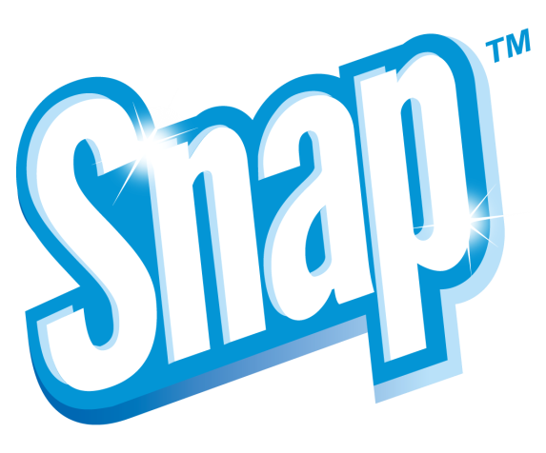
Leigh-Anna Ballard
MA International Convention
August 11, 2013

Slide 2
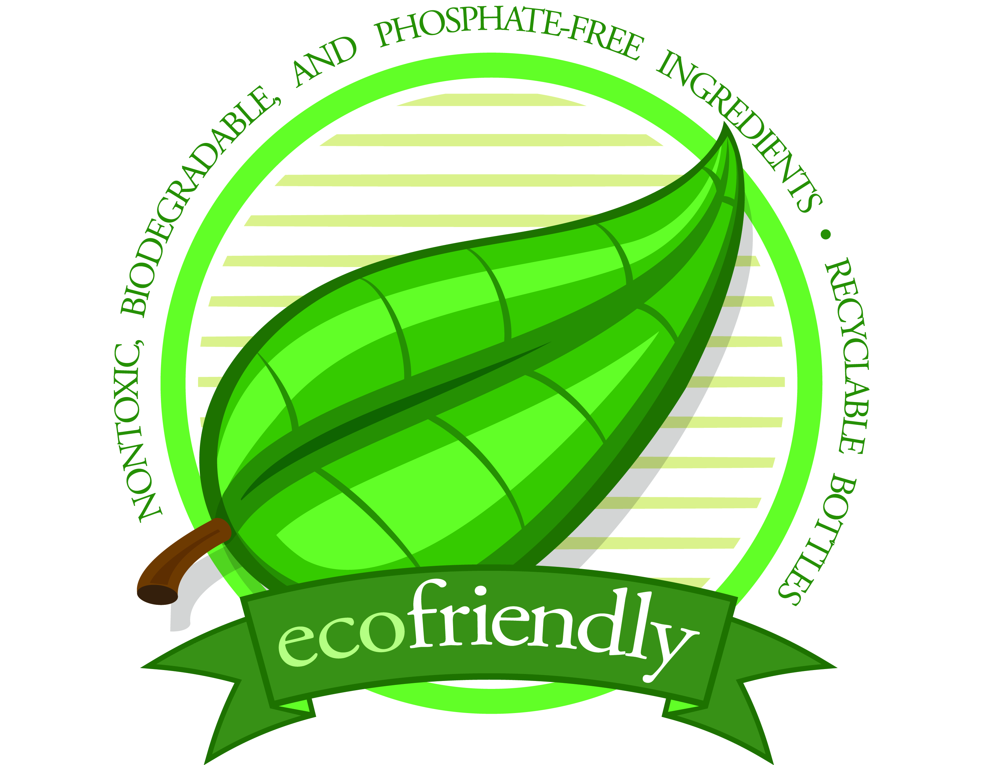
Snap™ Products – The Beginning
Snap originated in 1995
Developed with the environment in mind, using plant-based ingredients
Many Snap products are
Biodegradable
Phosphate-free
Non-toxic
Use recyclable bottles

Slide 3
Top Benefits of Snap Products
Concentrated
Versatile
Economical

Slide 4
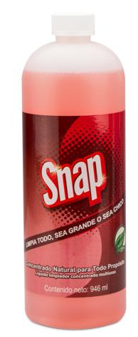
Snap™ All-Purpose Natural Concentrate
Primary Benefits:
Highly concentrated, versatile, multipurpose cleaner
One bottle replaces a cabinet full of leading household cleaners
Excellent for upholstery, walls, jewelry, ceramic tile, countertops and vinyl
Perfect for spot-cleaning and removing pen ink, shoe polish, lipstick and auto grease
Tough on dirt, gentle on hands
Environmentally friendly
Safe for septic systems

Slide 5
Snap™ All-Purpose Natural Concentrate
Primary Uses:
Cleans walls, counter tops, floors and woodwork
Removes dirt from hands gently and effectively
Jewelry cleaner
Spot and stain remover
Upholstery cleaner
Car wash
Laundry pre-wash
Fine linens
Cleans makeup brushes

Slide 6
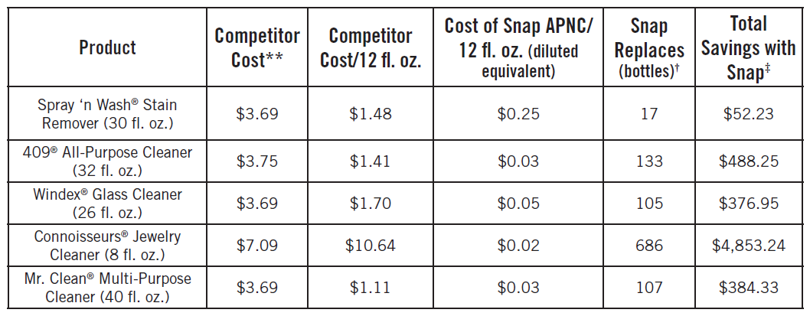
Savings with Snap APNC
One bottle can replace up to 133 bottles of the leading all-purpose cleaner
Over $480 in savings!

Slide 7
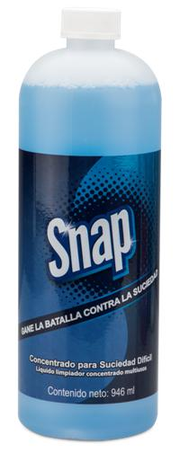
Snap™ Heavy-Duty Concentrate
Primary Benefits:
Highly concentrated, versatile, commercial-grade cleaner
Excellent for steam-cleaning carpets, and removing grease, oil and rust
Cleans windows, screens, tile and grout, Formica® and painted surfaces
Perfect for grills, stoves, ovens, and pots and pans
Safe for septic systems

Slide 8
Snap™ Heavy-Duty Concentrate
Primary Uses:
Removes grease, oil and rust from carpet
Steam Cleaning Carpet
Cleans windows and screens
Bathroom tile and Formica
Painted surfaces – walls, shelves, doors and more
Grills, stoves, ovens, pots and pans
Stripping wax
Glue remover
Spot remover on carpet or clothing
Laundry pre-wash
Outdoor plastic furniture
Removes grease, oil and grime from driveways and garage floors
Use in pressure washer for awning, siding and decks
Cleans engines and tires

Slide 9
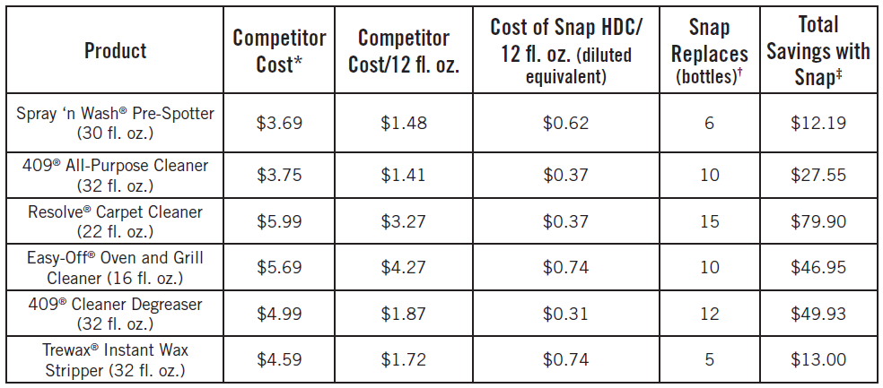
Savings with Snap Heavy-Duty
One bottle can replace up to 12 bottles of the leading degreaser
Over $49 in savings!

Slide 10
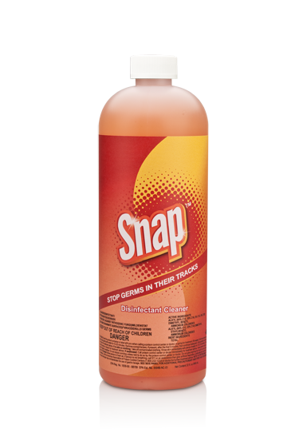
Snap™ Disinfectant Cleaner
Primary Benefits:
Cleans, disinfects and deodorizes
Concentrated cleaner, sanitizer, fungicide, virucide and mildewstat
Perfect for bathrooms, kitchens, hospitals, pet kennels, nursing homes, athletic/recreational facilities, food service establishments
Phosphate free
Readily biodegradable
EPA-approved disinfectant

Slide 11
Snap™ Disinfectant Cleaner
Primary Uses:
Disinfect hard, non-porous, inanimate and environmental surfaces such as
Floors
Walls
Metals surfaces
Glazed porcelain and ceramic tile
Plastic surfaces
Vinyl surfaces
Chrome surfaces
Also can be used effectively against bactericidal, fungicidal and virucidal activity

Slide 12
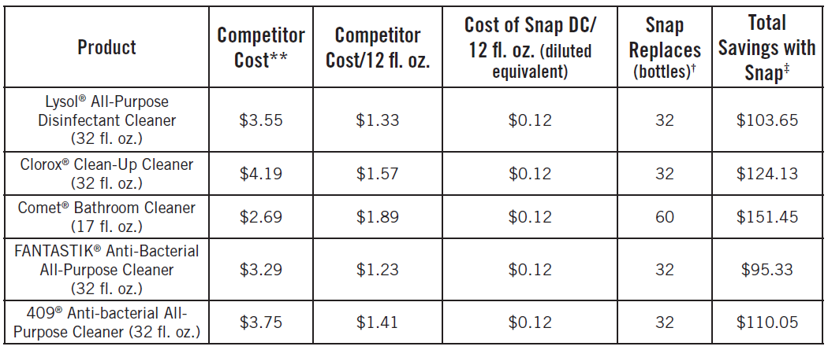
Savings with Snap Disinfectant
One bottle can replace up to 32 bottles of the leading anti-bacterial all-purpose spray
Over $100 in savings!

Slide 13
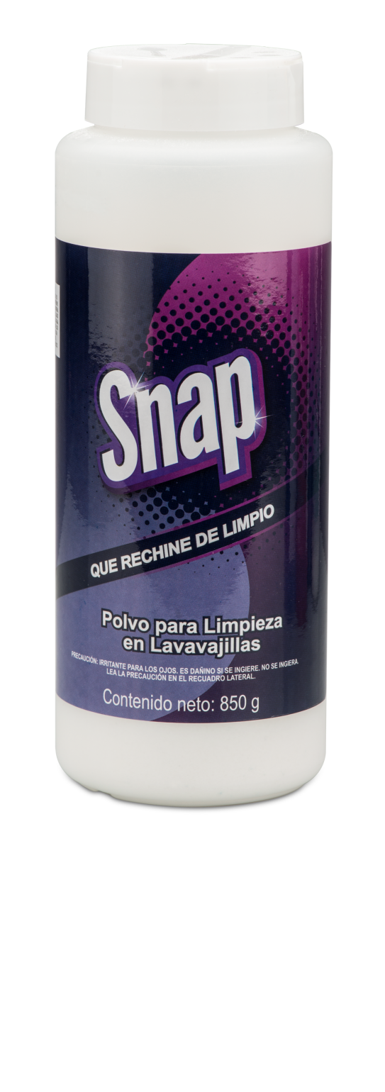
Snap™ Crystal Clean Automatic Dishwashing Crystals
Primary Benefits:
Blasts off dried foods and baked-on solids without the need to pre-wash
Increased rinsing action eliminates water spots and residue
Safe for dishwasher-safe porcelain and fine china
Will not tarnish pots and pans
Concentrated
Economical
Biodegradable, phosphate free
Safe for septic systems

Slide 14
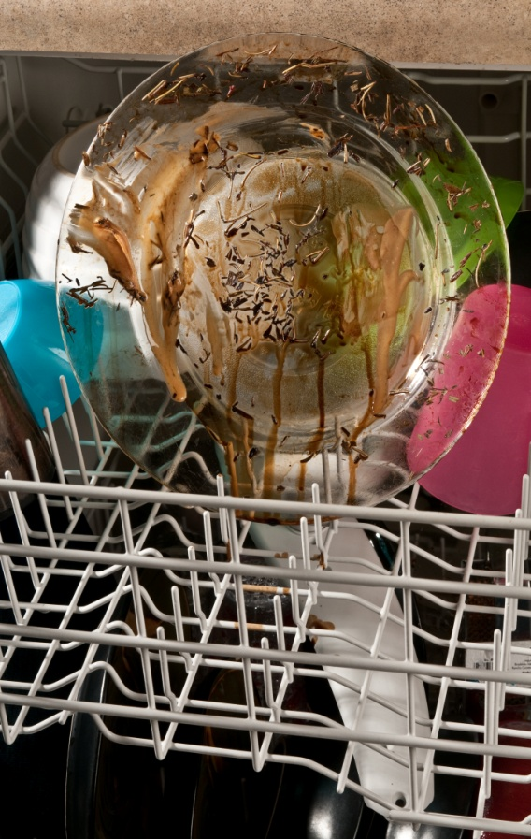
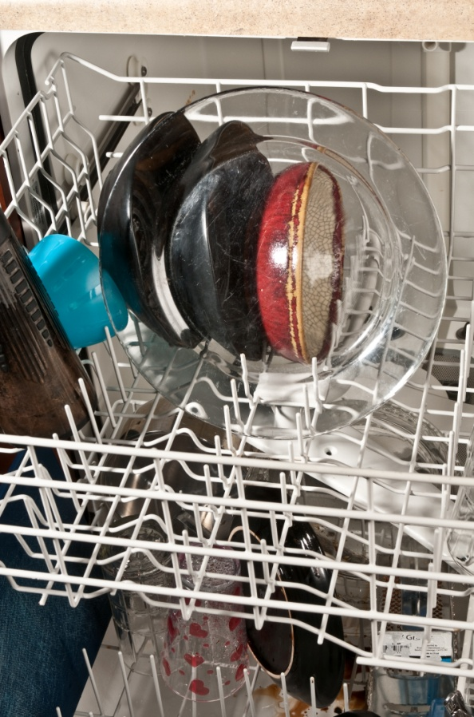
Before After
Snap™ Crystal Clean Automatic Dishwashing Crystals
Notes:
Here you can see the before and after of a clear glass dish. Stuck on food residue was washed easily away with the new reformulated dishwashing crystals. Keep in mind these three main contributing factors to the effective use of Snap Crystal Clean Automatic Dishwashing Crystals. If you have hard water you will want to add slightly more than ½ tablespoon of the dish crystals into your dishwasher to improve cleaning ability. Water temperature is key to proper dissolving of the crystals to effectively remove stains and residue. Use hot water at approximately 150° F. Check the setting on your water heater to ensure proper temperature. Finally, unless you have hard water, use no more than the ½ tablespoon recommended. A little goes along way with Snap Crystal Clean Automatic Dishwashing Crystals

Slide 15
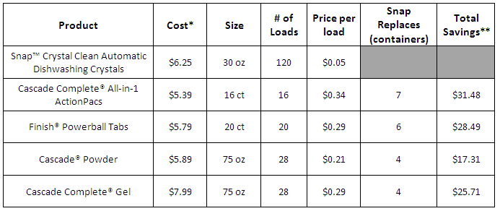
Savings with Snap Crystal Clean Automatic Dishwashing Crystals
One will clean up to 120 loads of dishes – replacing up to 6 competitor containers.
Over $31 in savings!

Slide 16
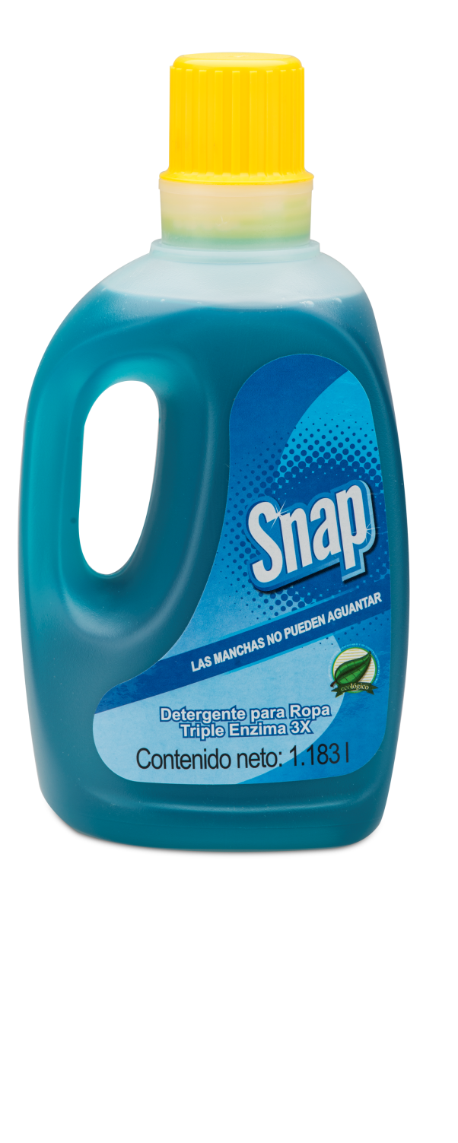
Snap™ Triple Enzyme 3X Laundry Detergent
Primary Benefits:
Triple enzyme stain-fighting power lifts oil, starch and protein-based stains
Odor-neutralizing formula
Increases whitening and color brightening power
Cleans in all water temperatures
For use in standard and HE washing machines
Economical
Environmentally friendly
Notes:
Our new Snap Triple Enzyme 3X Laundry Detergent is 3x more concentrated than standard detergents, which means you can do more laundry for less. One bottle does up to 50% more loads than the leading brands. Wash 40 large loads or 60 medium loads in standard washers. It’s perfect for high efficiency washers – just use half the recommended amount to do up to 80 loads in your high efficiency washer. Snap Triple Enzyme 3X Laundry Detergent was formulated to use in all temperatures. Snap works just as effectively in cold water as it does in warmer water, enabling you to save money on energy costs and in keeping with our commitment to green cleaning solutions, Snap Triple Enzyme 3X Laundry Detergent is an eco-friendly laundry solution with biodegradable, non-toxic, phosphate-free and plant-based surfactants and essential oils. While these are all great advantages the best part is the improved cleaning power of our newly formulated laundry detergent.

Slide 17
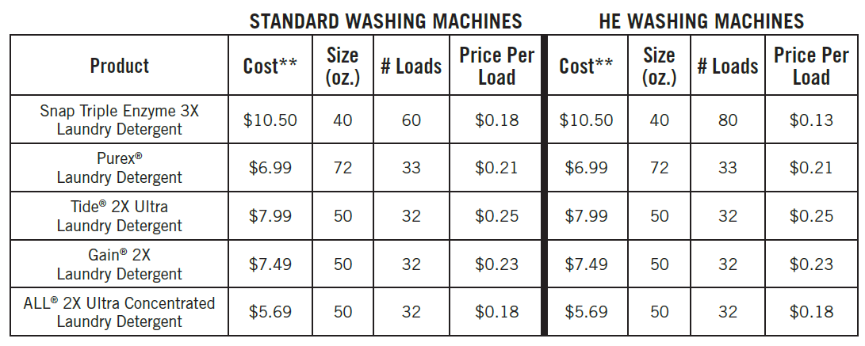
Savings with Snap Triple Enzyme 3X Laundry Detergent
More than twice as many loads as the leading 50-ounce bottle of HE laundry detergent
Save half the cost per load as compared to the leading HE detergent

Slide 18
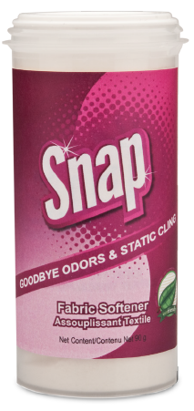
Snap™ Fabric Softener
Primary Benefits:
Eliminates static cling
Leaves clothes fresh and amazingly soft
Freshens up hampers, gym bags and smelly shoes
Freshen up pet bedding
Deodorizes and removes static from carpet
Highly concentrated
Environmentally friendly

Slide 19
Savings with Snap Triple Enzyme 3X Laundry Detergent
One container replaces up to 12 boxes of the leading fabric softener dryer sheets
Over $60 in savings!

Slide 20
How to sell Snap
Handouts and Product Information Sheets
Home Advisor
Product Demonstrations
Personal Experience

Slide 21
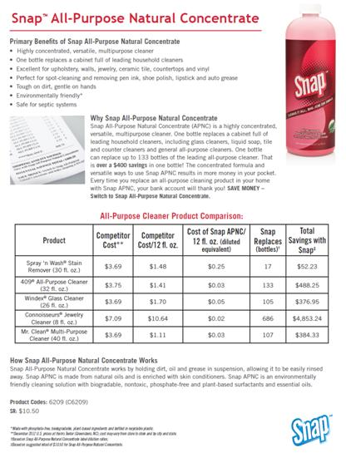
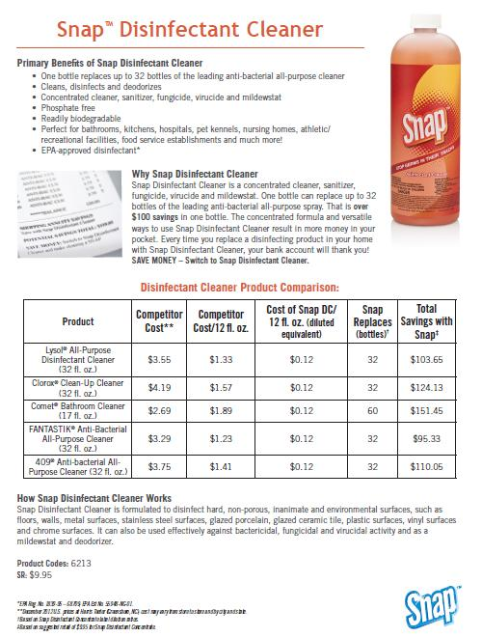
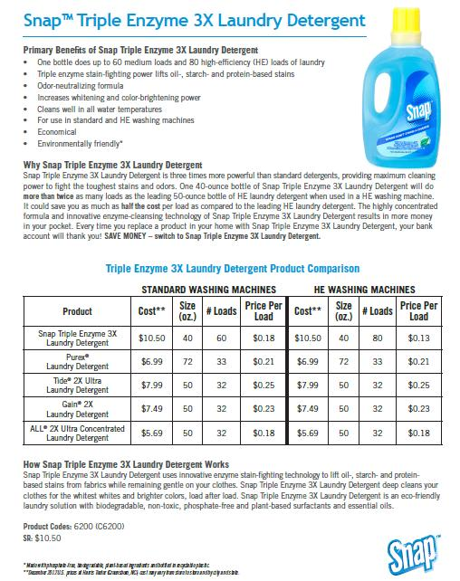
Snap™ Product Information Sheets
Available as a Download on unFranchise.com

Slide 22
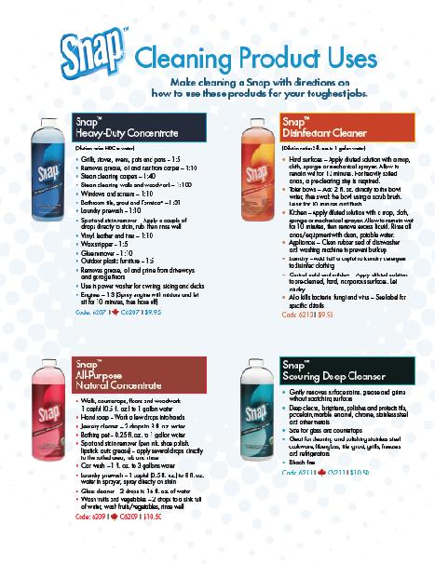
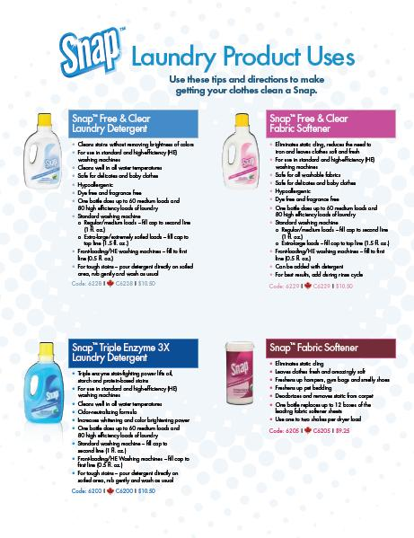
Snap™ Quick Reference Cleaning & Laundry Handouts
Available as a Download on unFranchise.com

Slide 23
How to sell Snap
Handouts and Product Information Sheets
Home Advisor
Product Demonstrations
Personal Experience

Slide 24
Demonstrations

Slide 25
How to sell Snap
Handouts and Product Information Sheets
Home Advisor
Product Demonstrations
Personal Experience

Slide 26
Snap™ All-Purpose Natural Concentrate
Notes:
Demonstrations for Snap All-Purpose Natural Concentrate
Do-It-Yourself All-Purpose Cleaning Wipes
Cleaning Fruits & Vegetables with APNC
You can use Snap All-Purpose Natural Concentrate to make Do-It-Yourself All-Purpose Cleaning Wipes. You will need Snap APNC, paper towels and an air tight container. I’m using a baby wipes container, but any will work. Start by folding about 25 paper towels accordion style, I’m using the select-a-size paper towels. Then cut the stack in half. Next I’ll put the two stacks of paper towels in the container. For 25 paper towels you will need 1 cup of water to moisten the towels. For 8 ounces of water, you will need 3 drops of Snap APNC. Only 3 drops! That’s how concentrated the product is! Pour the Snap solution over the paper towels making sure to moisten all of the towels. Close the lid and there you go, Snap All-Purpose Cleaning wipes for a fraction of the cost of the ones in the store. You can also use this same concept and make glass cleaning wipes using Snap Heavy-Duty Concentrate or disinfecting wipes using Snap Disinfectant Cleaner. Make sure to use the correct dilution rate per the product label.
You can also use Snap APNC to Cleaning Fruits and Vegetables. Fill up a clean bowl or clean sink with water and add 2 drops of Snap APNC and mix will. Add the fruits or vegetables and let soak for a few minutes. You can take a soft brush and gently scrub them. Make sure to rinse well before eating.

Slide 27
Snap™ Heavy-Duty Concentrate
Notes:
Demonstrations for Snap Heavy-Duty Concentrate
Carpet Cleaning
Tire Cleaning
Microwave/Oven Cleaning
Snap Heavy-Duty Concentrate is a great carpet cleaner. It can be used in a household steam cleaner or directly on the spot. This is a ketchup stain on this piece of carpet. Pour a little Heavy-Duty Concentrate directly on the spot and use a cloth or brush and scrub. This isn’t a fresh stain; it’s been on this carpet for several months. As you see, it is easily removed with Snap Heavy-Duty Concentrate.

Slide 28
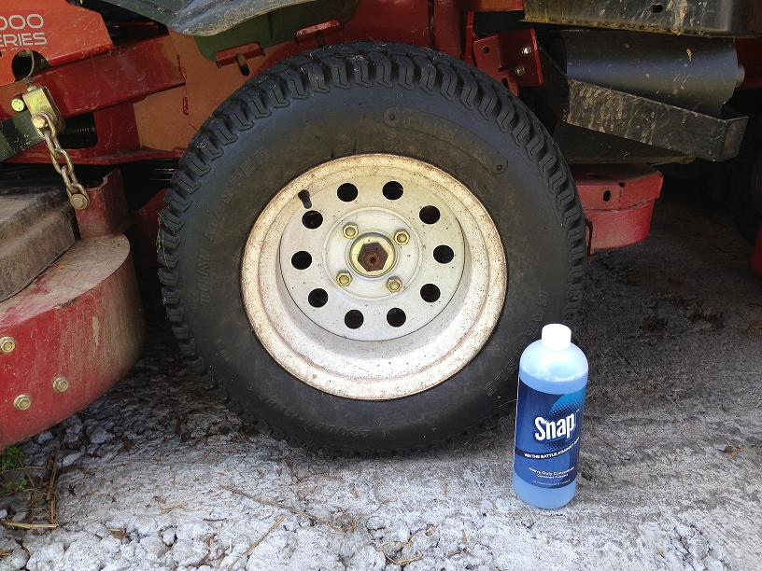
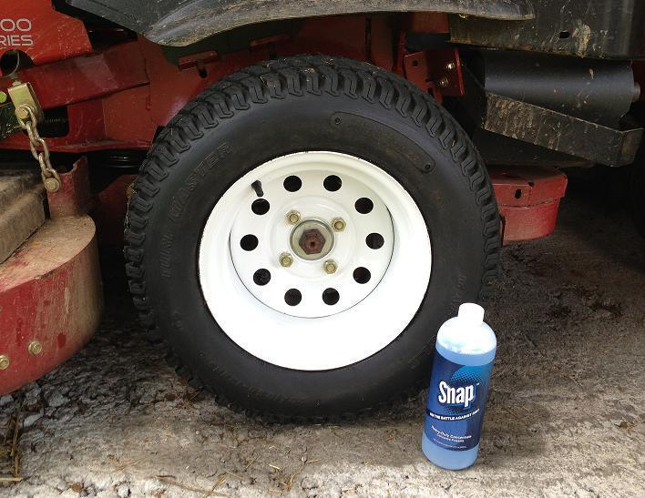
Cleaning Tires with Snap™ Heavy-Duty
Before
After

Slide 29
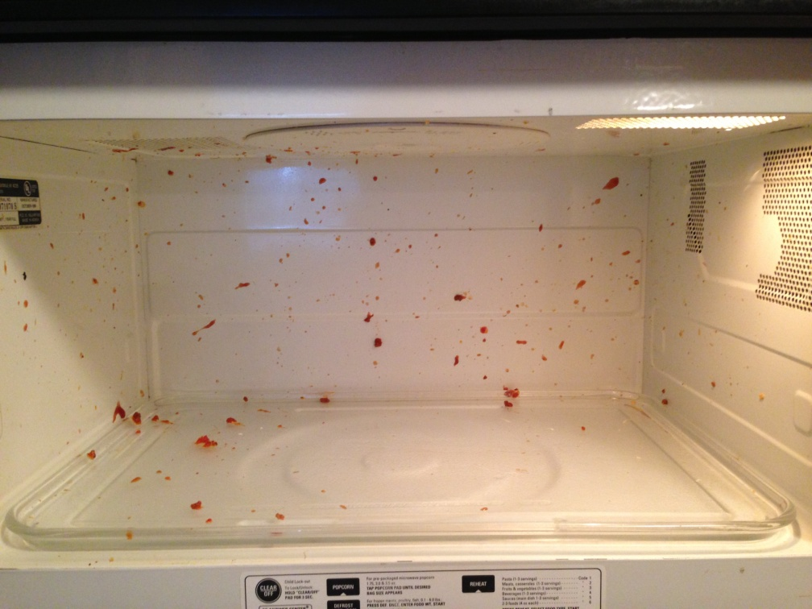
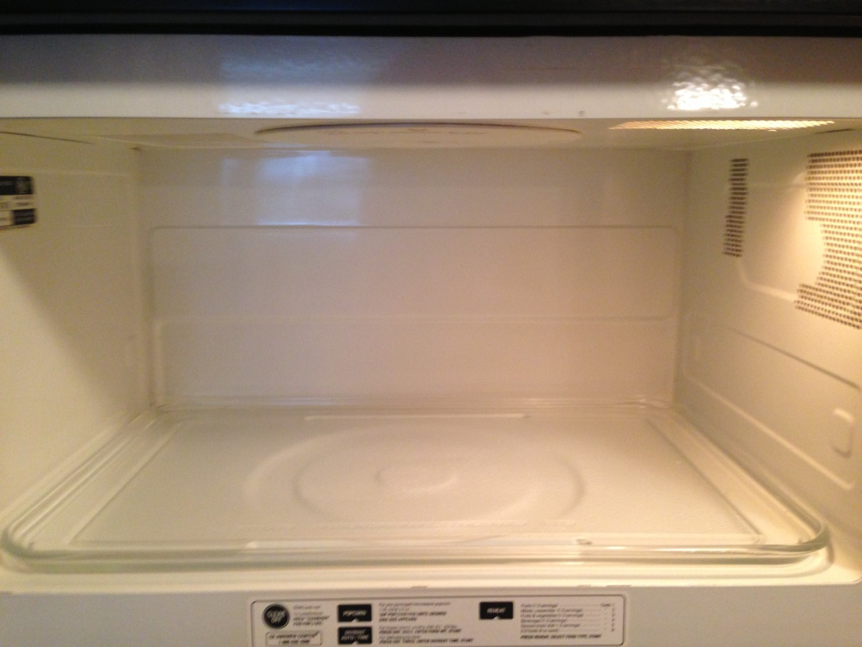
Cleaning the Microwave with Snap™ Heavy-Duty
Before
After

Slide 30
Snap™ Fabric Softener
Notes:
Demonstrations for Snap Fabric Softener
Not only will it freshen your clothes, you can use it to freshen smelly shoes and pet bedding. It can also to deodorize and remove static from carpet.

Slide 31
How to sell Snap
Handouts and Product Information Sheets
Home Advisor
Product Demonstrations
Personal Experience

Slide 32
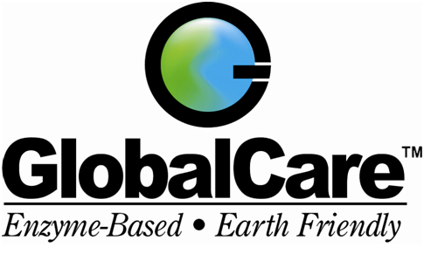
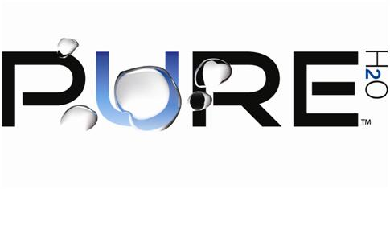
www.facebook.com/mahappyhome

