Slide 1
Demonstrations…
Heavy Duty Concentrate
All Purpose Natural Concentrate
Disinfectant Cleaner

Slide 2
Performing Snap™ Demos
Review step-by-step instructions
Purchase demonstration items
Practice, Practice, Practice
The demonstrations are effective with a confident, rehearsed demonstrator

Slide 3
Using Snap™ Demos
Product presentations to prospective clients
Consider taping demonstrations and adding to your distributor site or blog.
Increase knowledge base on Snap products
Act as a testimonial to the effectiveness of Snap cleaning products

Slide 4
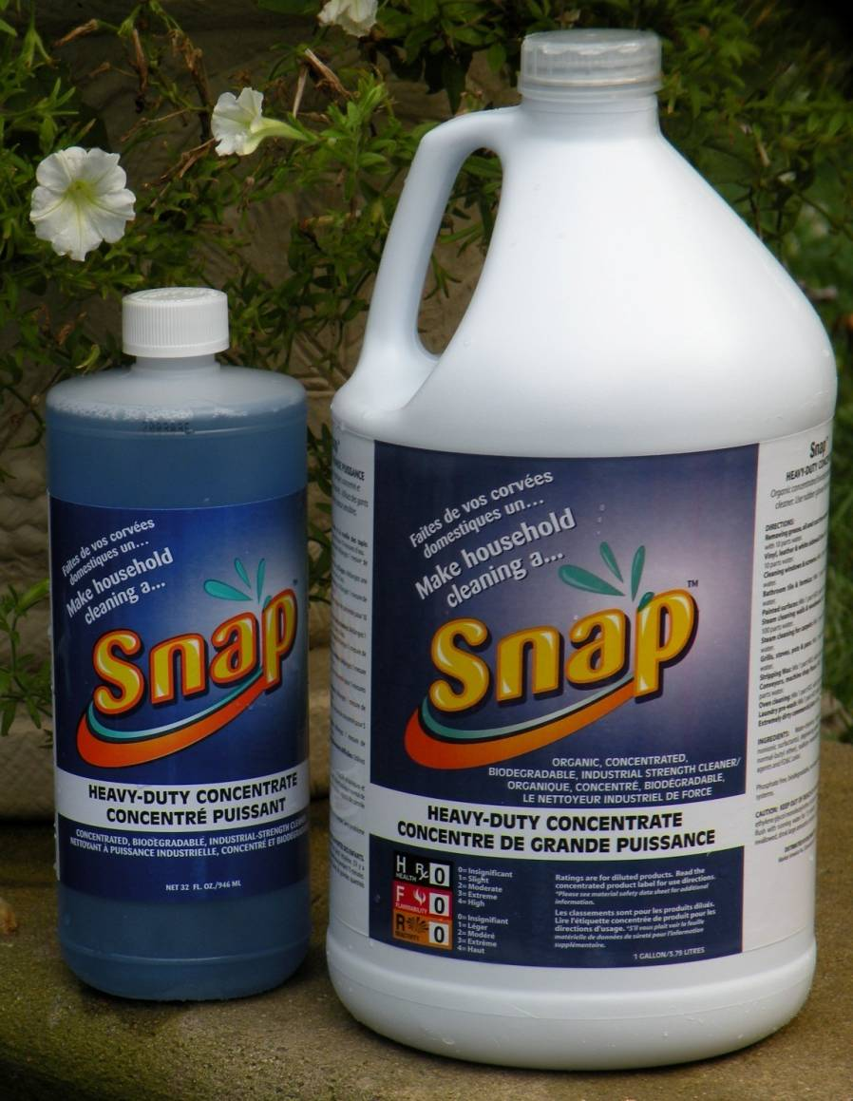
Snap™ Heavy Duty Concentrate
Highlights:
Unique blend of degreasing agents
Readily biodegradable
Increased coupling advantages and electrolyte solubility
Increased wetting ability over commonly used E-series Glycol Ethers
Slower evaporation rate, low VOC
Code: 6207 (C6207)
DC: $7.00 SR: $9.95 BV: 5

Slide 5
Snap™ Heavy Duty Concentrate
Uses:
Household Replacements
Formula 409
Spot remover
Carpet cleaner
Automotive Replacements
Wheel cleaner
Vinyl cleaner
Brake Cleaner
Engine Cleaner
Commercial Replacements
Floor cleaners
Machine and ink cleaners
Glue cleaners
Wax stripper

Slide 6
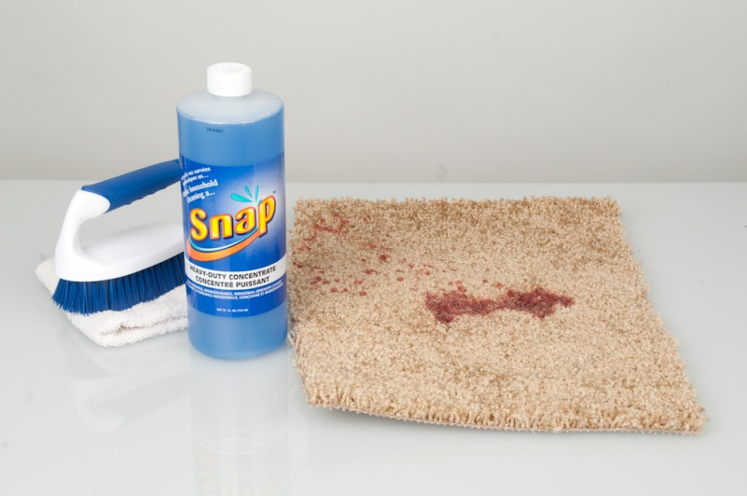
Snap™ Heavy Duty Concentrate
What you will need…
Bottle of Snap™ Heavy Duty Concentrate
Strip of carpet
Pre-stained with soda, dirty oil, grease, red wine or grape juice
Scrub brush or good quality wash cloth
Volunteer

Slide 7
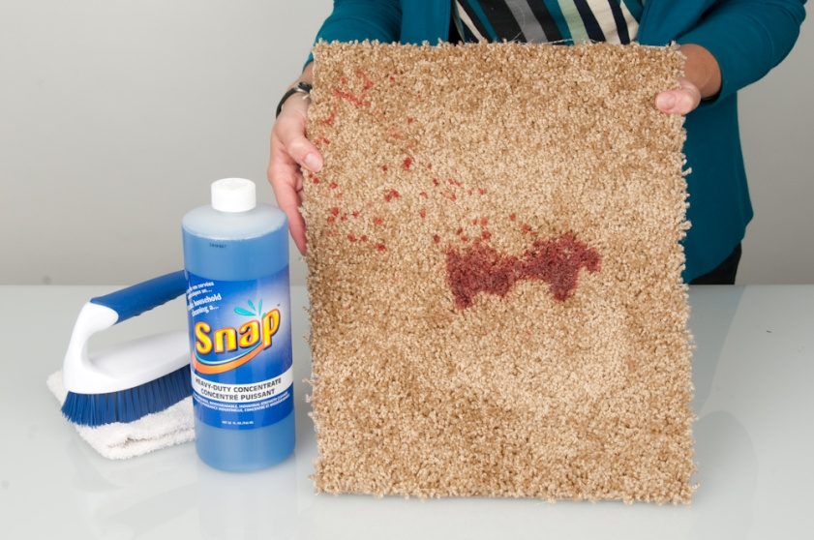
Snap™ Heavy Duty Concentrate
What you need to do…
Hold up carpet, pre-stained with soda, dirty oil, grease, red wine or grape juice for audience to confirm that carpet is soiled (or have volunteer hold up to show audience soiled carpet).

Slide 8
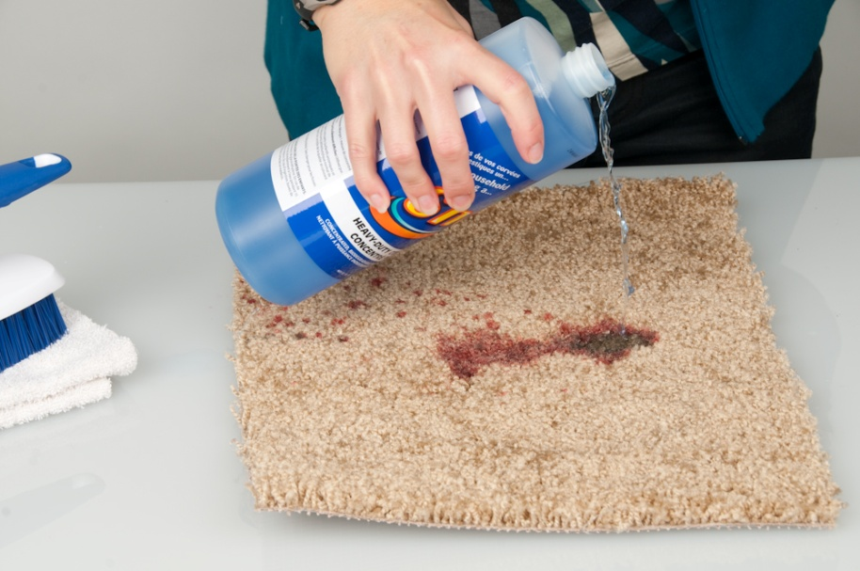
Snap™ Heavy Duty Concentrate
What you need to do…
Pour Snap™ Heavy Duty Concentrate – full strength - onto one side of the stains.

Slide 9
Snap™ Heavy Duty Concentrate
What you need to do…
Use scrub brush or wash cloth and clean the side with the Heavy Duty Concentrate applied. If you have a volunteer have them do this step.

Slide 10
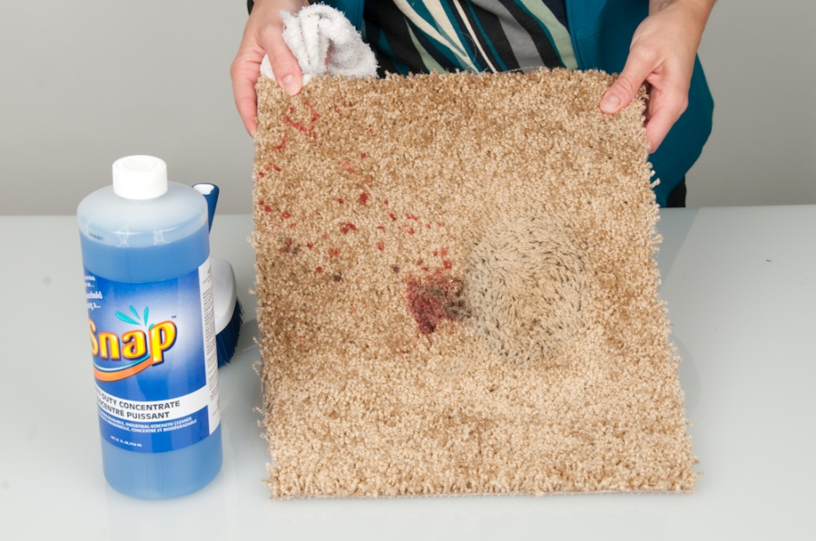
Snap™ Heavy Duty Concentrate
What you need to do…
Hold up carpet to show stains on one side of the carpet are now removed.
RESULT: Half the stains are completely removed
Practice, Practice, Practice!

Slide 11
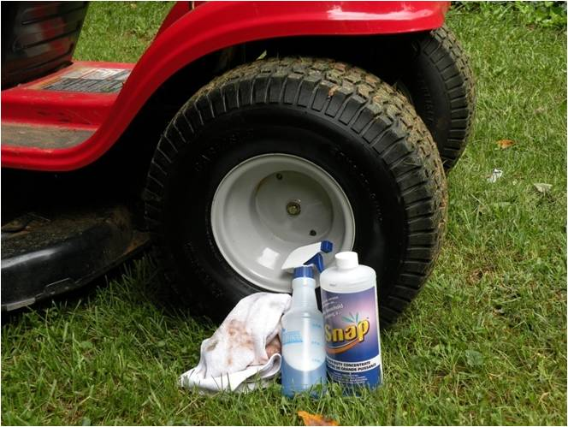
-Before -After
Snap™ Heavy Duty Concentrate

Slide 12
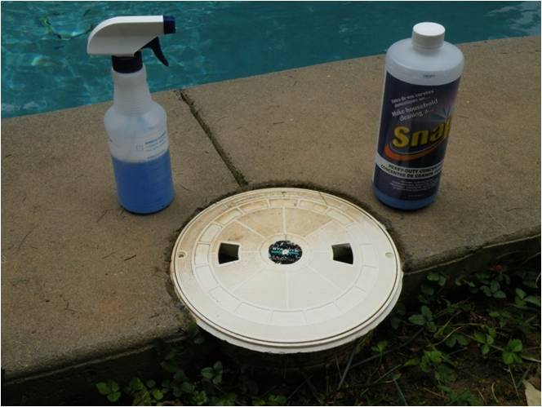
-Before -After
Snap™ Heavy Duty Concentrate

Slide 13
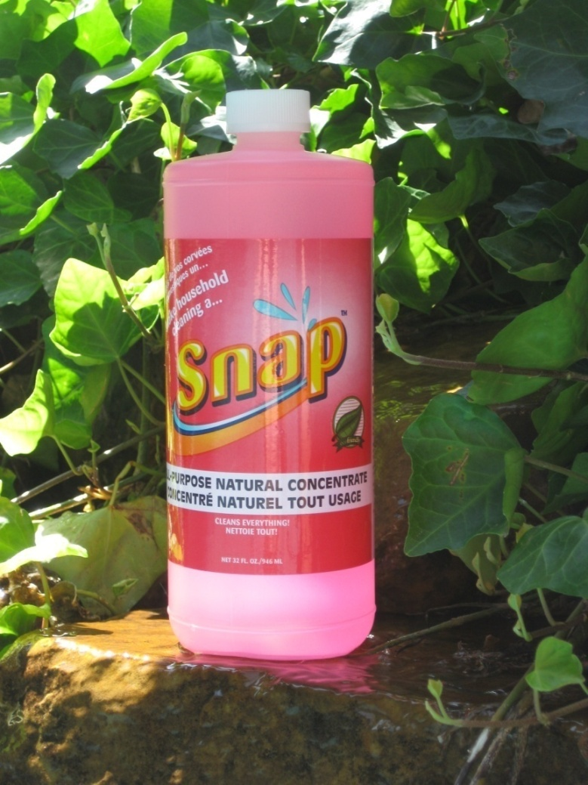
Snap™ All-Purpose Natural Concentrate
HIGHLIGHTS:
Highly concentrated, multifunctional, biodegradable
Two expensive blends of coconut oil surfactants (alkanolamides), utilizing cosmetic chemistry
Fragrance blend of essential oils, sweet almond oil, and anis seed oil
Code: 6209 (C6209)
DC: $7.25 SR: $10.50 BV: 5

Slide 14
Snap™ All-Purpose Natural Concentrate
Uses
Personal
Hand wash
Bubble bath
Body soap
Jewelry cleaner
Household
Floor and wall cleaner
Pots and pans scrub
Wood cabinets
Fine linens
Pet shampoo
Window cleaner
Automotive
Car wash
Window cleaner
Upholstery cleaner
Waterless hand cleaner
Commercial
Hand cleaner
All-purpose cleaner
Window cleaner
Car wash
Light duty cleaner
Headstones
Notes:
Video of the dog

Slide 15
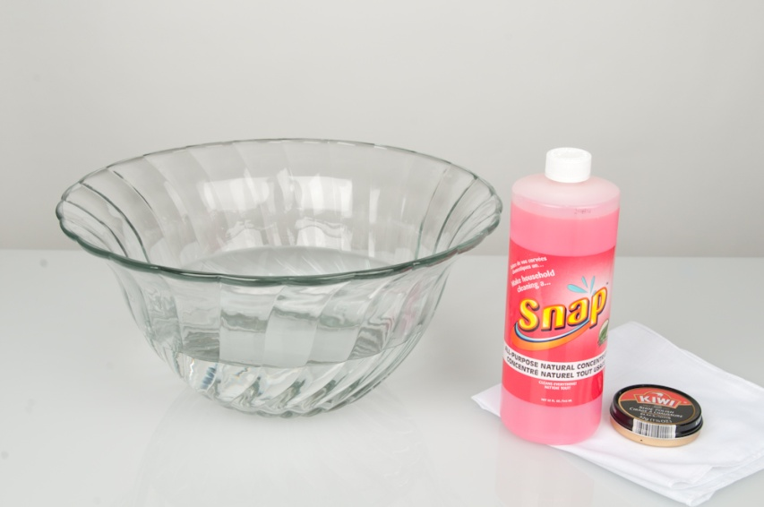
Snap™ All-Purpose Natural Concentrate Demonstration
What you will need…
Snap™ All Purpose Natural Concentrate
Large glass bowl of warm water
Black Kiwi™ shoe polish
Clean, white, cotton handkerchief
Volunteer
Notes:
Video of big poppa doing the demonstration

Slide 16
Snap™ All-Purpose Natural Concentrate Demonstration
What you need to do…
Fill large glass bowl with warm water.
Notes:
Video of big poppa doing the demonstration

Slide 17
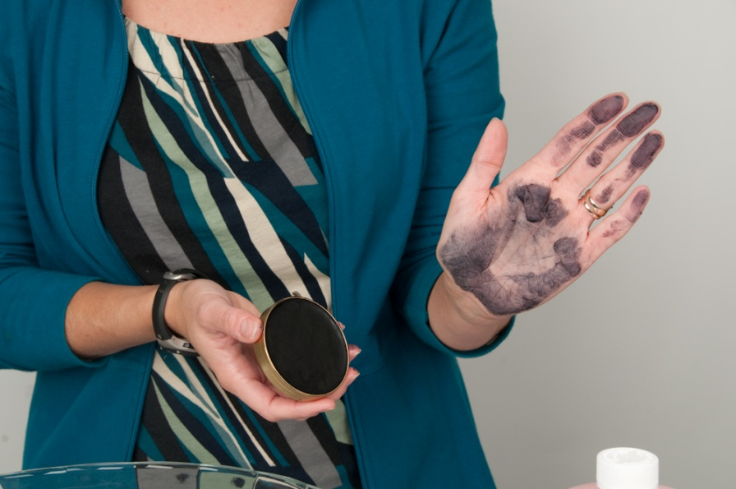
Snap™ All-Purpose Natural Concentrate Demonstration
What you need to do…
Rub shoe polish on your hand or the hand of your volunteer.
Hold up your hand (or have volunteer hold up their hand) to show audience that your hand is covered in shoe polish.
Notes:
Video of big poppa doing the demonstration

Slide 18
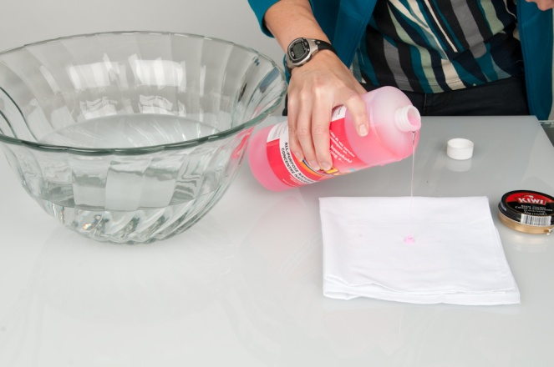
Snap™ All-Purpose Natural Concentrate Demonstration
What you need to do…
Dab a little All Purpose Natural Concentrate on your hand (or volunteers hand) and on the handkerchief.
Notes:
Video of big poppa doing the demonstration

Slide 19
Snap™ All-Purpose Natural Concentrate Demonstration
What you need to do…
Dip the handkerchief in water.
Notes:
Video of big poppa doing the demonstration

Slide 20
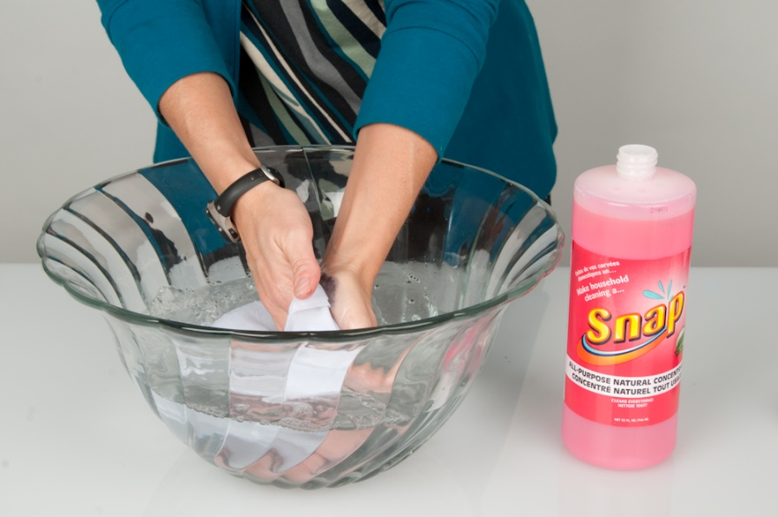
Snap™ All-Purpose Natural Concentrate Demonstration
What you need to do…
Wash hands in the bowl using the handkerchief.
Notes:
Video of big poppa doing the demonstration

Slide 21
Snap™ All-Purpose Natural Concentrate Demonstration
What you need to do…
RESULT: your hand AND the handkerchief will be clean
Practice, Practice, Practice!
Notes:
Video of big poppa doing the demonstration

Slide 22
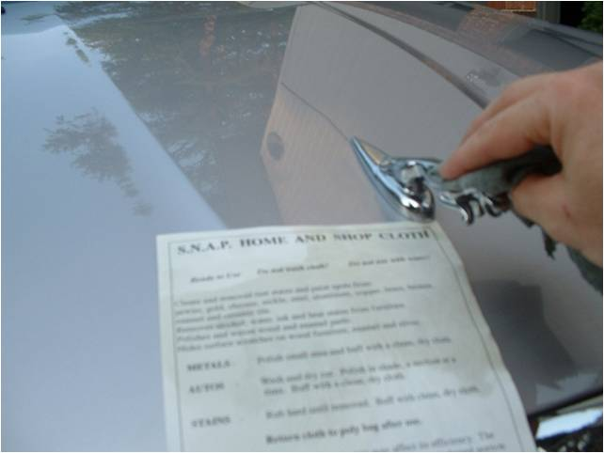
Snap™ Home & Shop Cloth
Highlights:
Quality cotton cloth treated with silicones and quality waxes
Great for dust, scratches, brass, glass, silver and stable gear – check compatibility
Safely removes oxidation
Code: 6217 (C6217)
DC: $23.00 SR: $31.95 BV: 13.50

Slide 23
Snap™ Home & Shop Cloth
Highlights:
Restores household wood
Great for cars
Scratches
Chrome wheels
Touchups
Rain spots
Water repellent for windshield
Water spots on windows
Code: 6217 (C6217)
DC: $23.00 SR: $31.95 BV: 13.50

Slide 24
Snap™ Home & Shop Cloth Demonstration

Slide 25
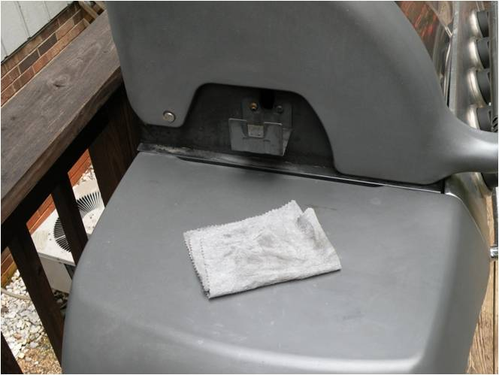
-Before -After
Snap™ Home & Shop Cloth

Slide 26
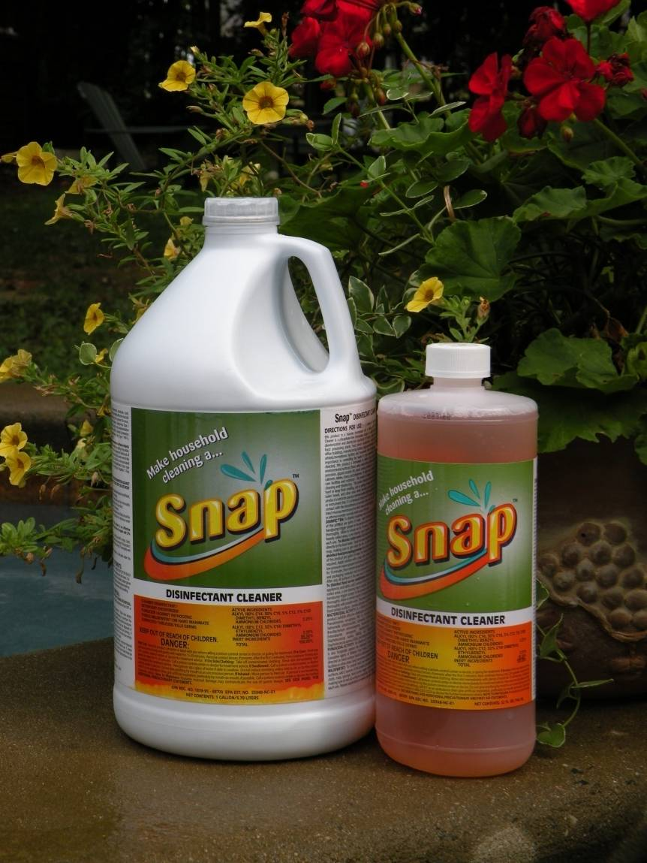
Snap™ Disinfectant Cleaner
Highlights:
Incredible cost savings
EPA Registered – top quality ingredients
Pleasant, clean, fresh fragrance from essential oils of lavender, peppermint, spearmint and cedar leaf
Kills E-Coli, Salmonella, Hepatitis B, MRSA and HIV
Effective against H1N1 (Swine Flu)
Code: 6213
DC: $7.00 SR: $9.95 BV: 5

Slide 27
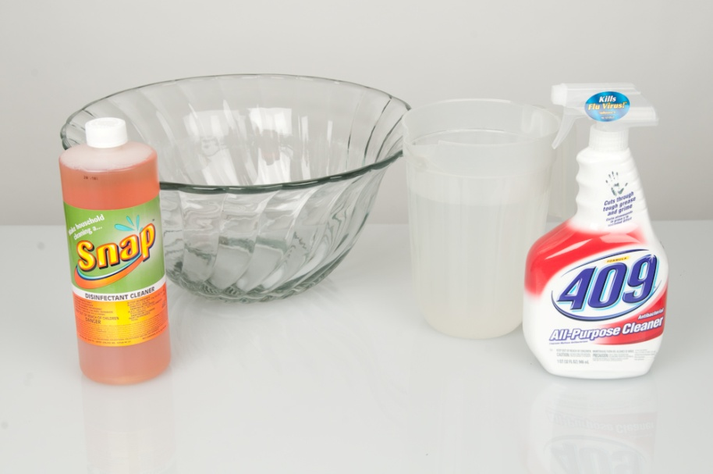
Snap™ Disinfectant Cleaner
What you will need…
Bottle of Snap™ Disinfectant Cleaner
Large bowl or trash can
32 oz bottle of 409 Disinfectant Cleaner
Pitcher of water
Notes:
Video of big poppa doing the demonstration

Slide 28
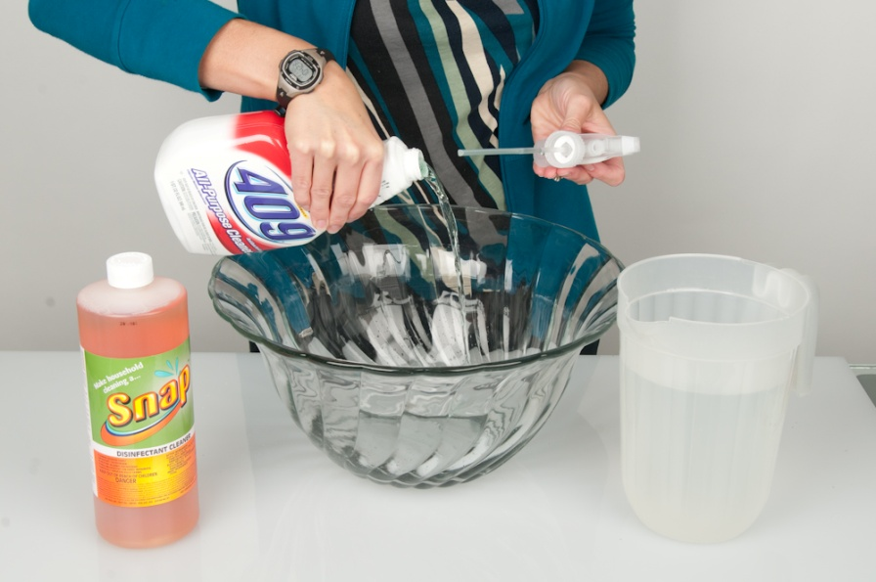
Snap™ Disinfectant Cleaner
What you need to do…
Dump the contents of the 409 into bowl or trash can.

Slide 29
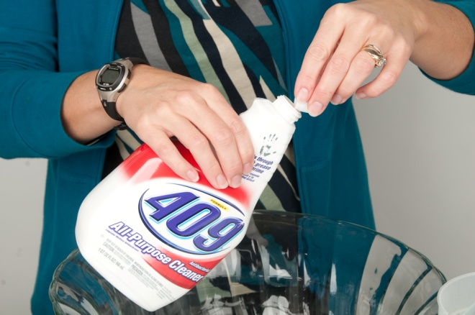
Snap™ Disinfectant Cleaner
What you need to do…
Measure out three capfuls of Disinfectant Cleaner and pour into empty 409 bottle.
Notes:
Video of big poppa doing the demonstration

Slide 30
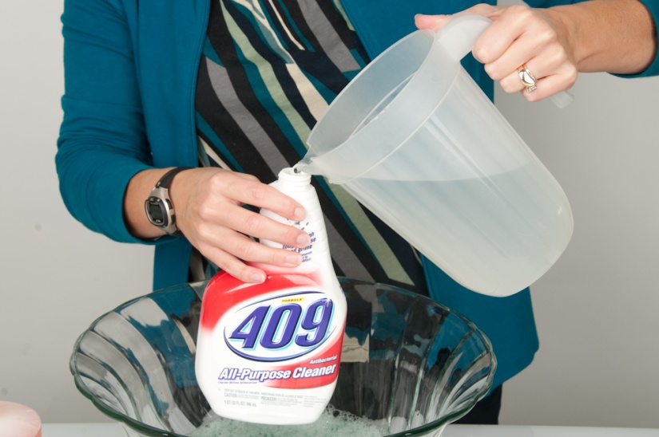
Snap™ Disinfectant Cleaner
What you need to do…
Fill the rest of the 409 bottle with water from the pitcher and replace cap.
Notes:
Video of big poppa doing the demonstration

Slide 31
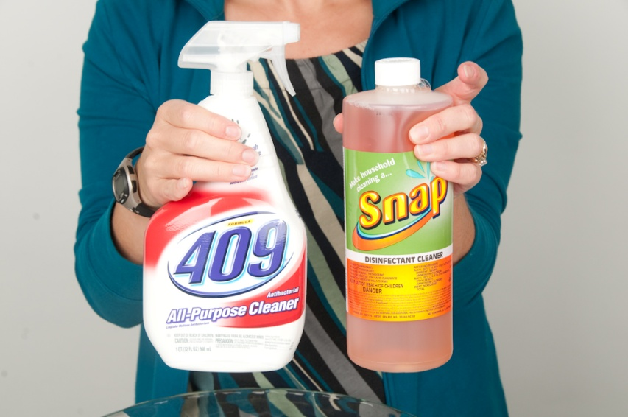
Snap™ Disinfectant Cleaner
What you need to do…
Hold up the bottle of 409 and the bottle of Disinfectant Cleaner
Say “one bottle of Snap™ Disinfectant cleaner replaces up to 36 bottles of 409”
Notes:
That concludes our snap product demonstration webinar. For a summary of this presentation including a list of items needed and the directions for how to complete the Snap product demonstrations please go to unfranchise.com, click on downloads and sales aids. Look for the sales aid titled How to Perform Snap Demo’s.

