Slide 2
UNIFIED ASIA-PACIFIC REGION (UAP)
Unified BV/IBV Banks
UNIFIED EUROPE REGION (UEU)
Unified BV/IBV Banks
UNIFIED AMERICAS REGION (UAM)
Unified BV/IBV Banks
Australia
Taiwan
Hong Kong
Singapore
United States
Canada
Mexico
Market Countries
United Kingdom
Spain
Bahamas
Colombia
Panama
Dominican Republic Ecuador
Jamaica
EMP Countries
New Zealand
Global SHOP.COM
Customers can buy Market America (USA) branded BV products
Customers can buy Market America (USA) branded BV products
Customers can buy Market America (USA) branded BV products

Slide 3
UNIFIED ASIA-PACIFIC REGION (UAP)
Unified BV/IBV Banks
UNIFIED EUROPE REGION (UEU)
Unified BV/IBV Banks
UNIFIED AMERICAS REGION (UAM)
Unified BV/IBV Banks
Australia
Taiwan
Hong Kong
Singapore
United States
Canada
Mexico
Market Countries
United Kingdom
Spain
Bahamas
Colombia
Panama
Dominican Republic Ecuador
Jamaica
EMP Countries
New Zealand
Global SHOP.COM
Customers can buy Market America (USA) branded BV products
Customers can buy Market America (USA) branded BV products
Customers can buy Market America (USA) branded BV products

Slide 4
UNIFIED ASIA-PACIFIC REGION (UAP)
Unified BV/IBV Banks
UNIFIED EUROPE REGION (UEU)
Unified BV/IBV Banks
UNIFIED AMERICAS REGION (UAM)
Unified BV/IBV Banks
Australia
Taiwan
Hong Kong
Singapore
United States
Canada
Mexico
Market Countries
United Kingdom
Spain
Bahamas
Colombia
Panama
Dominican Republic Ecuador
Jamaica
EMP Countries
New Zealand
Global SHOP.COM
Customers can buy Market America (USA) branded BV products
Customers can buy Market America (USA) branded BV products
Customers can buy Market America (USA) branded BV products

Slide 5
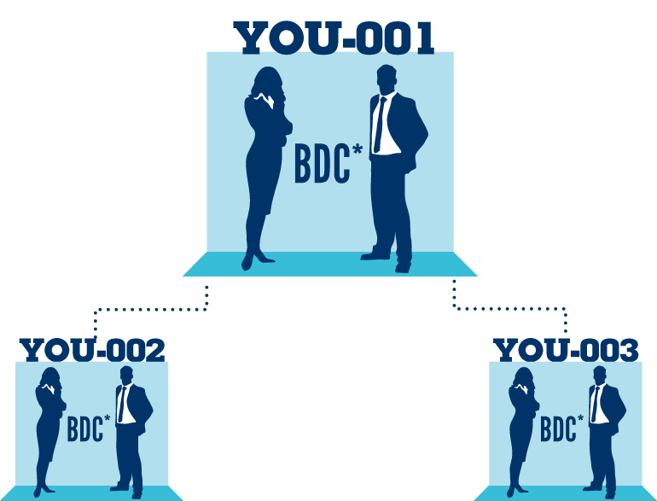
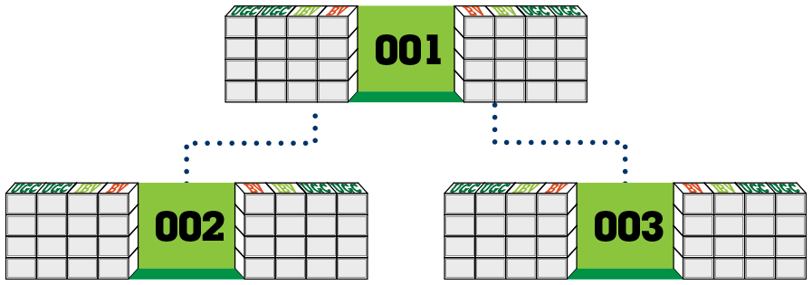
All UFOs are awarded an IRC (International Re-entry Center) for each "Expanded Region" for future placement
IRCs allow for earning additional commissions from regional global expansion
IRCs convert “Expanded Region” BV/IBV to earn in “Home Region” MPCP
All UFOs are awarded 3 UGCs (Unified Global Center) for EACH "Expanded Region" when each IRC is placed
UGCs accrue from “Expanded Region” BV/IBV in excess of 5,000 “Home Region” BV
Expand to America’s
Expand to Europe

Slide 7
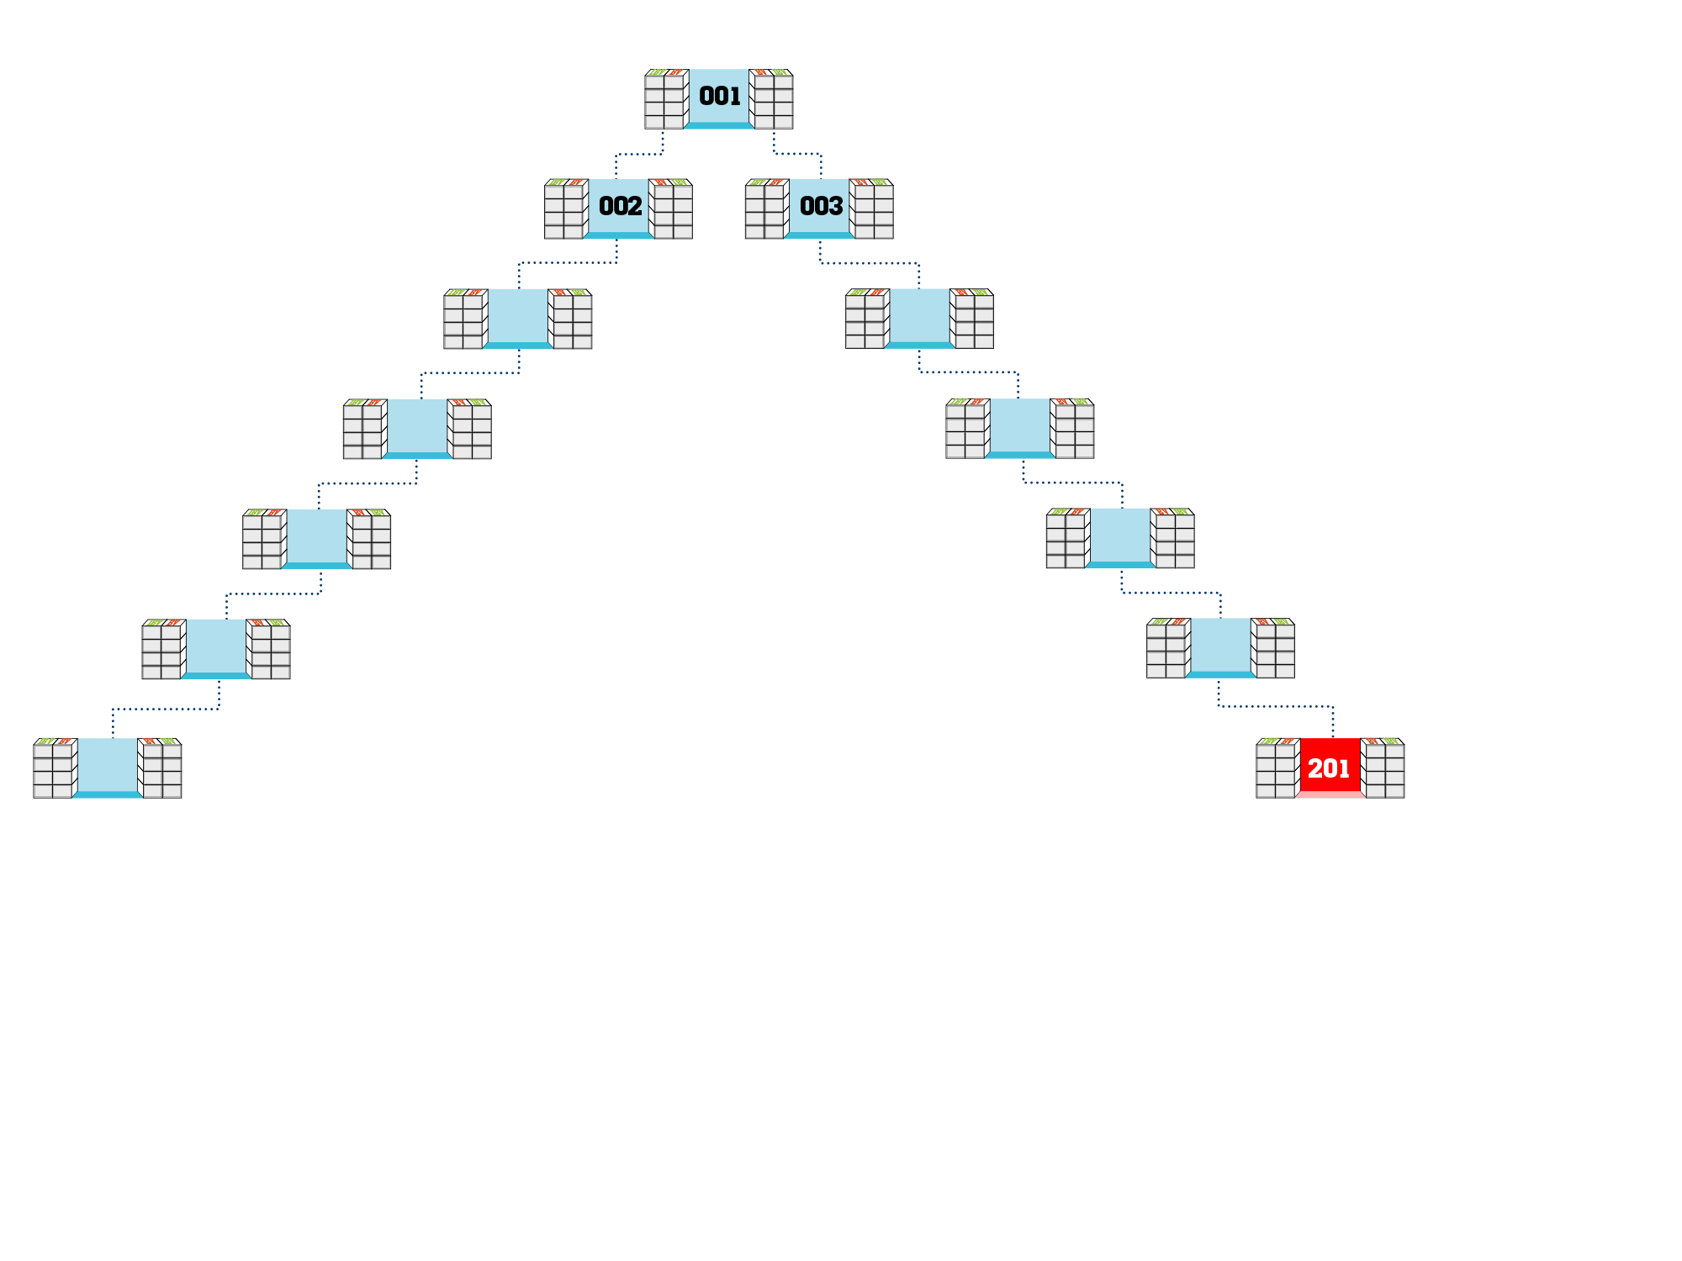
200BV
In order for an IRC to accrue BV/IBV from the “Expanded Region”, UFOs have to place and qualify the IRC with a 200 BV product order

Slide 8
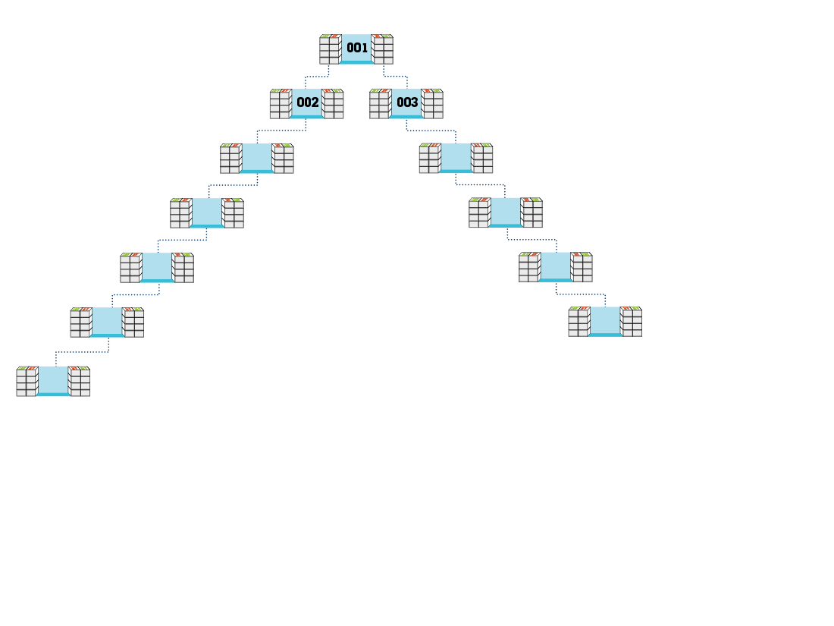
600
600
600
600
600
600
600
300
300
“Expanded Region” BV is converted to “Home Region” BV and is accrued by all qualified BDCs in “Home Region” above IRC

Slide 9
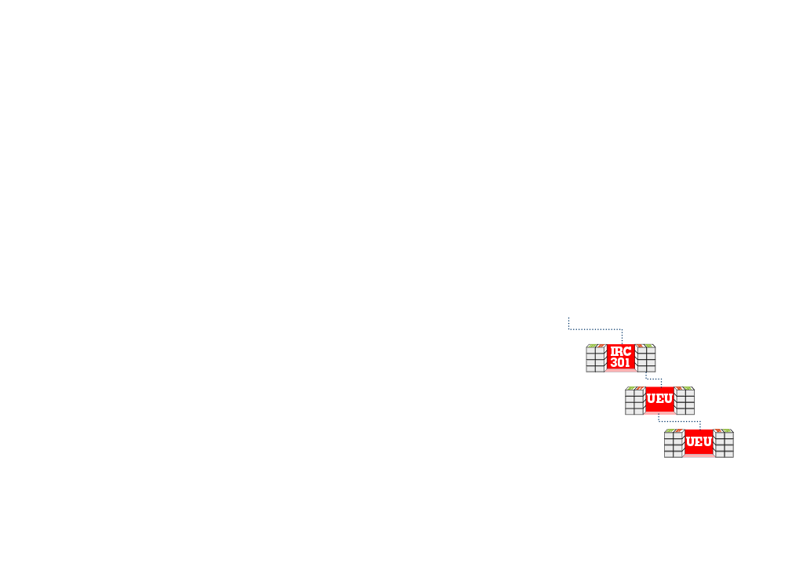
A UEU IRC must be Activated with UFOs from the UEU Region to earn commissions

Slide 10
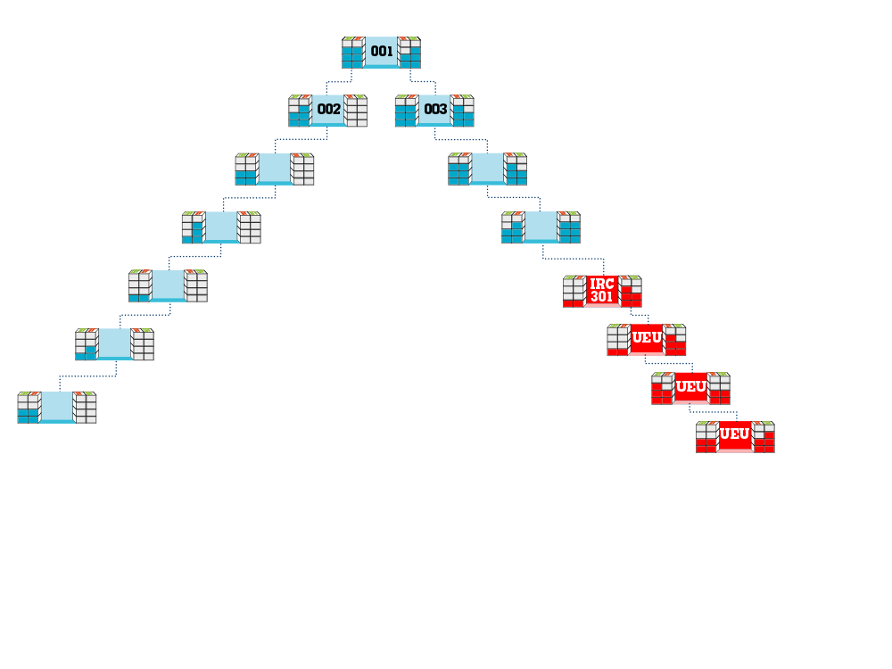
5,400
(Balance)
3,300
(Balance)
+ 600 = 3,900
($375
Commission)
3,000
(Balance)
+ 600
2,600
(Balance)
+ 600
1,000
(Balance)
+ 600
600
600
600
300
300
Converted “Expanded Region” BV generated from “Expanded Region” BV will accrue to meet payout criteria in respective “Home Region” MPCP

Slide 11
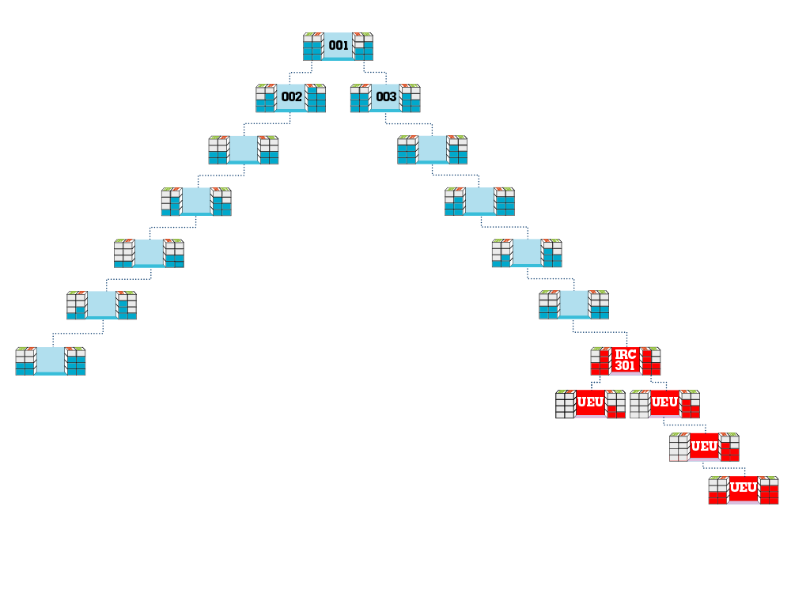
The first time your UEU IRC accrues 5,000 BV/5,000 BV, one additional UEU IRC is awarded for reentry

Slide 12
UEU UGC “Banks” for 3 BDCs (001, 002, 003) are opened upon placement of your UEU IRC

Slide 13
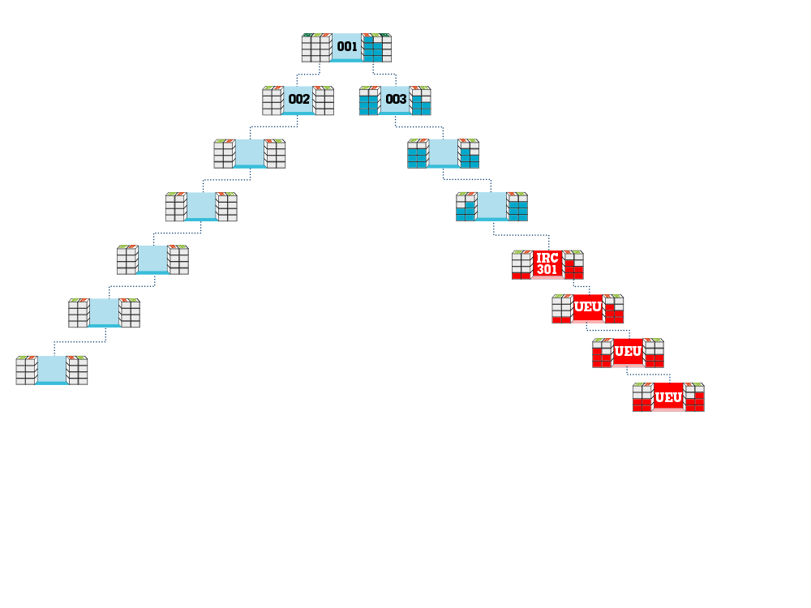
300 BV
(UGC Bank)
+ 300 = 5,300
5,000
(Previous Balance)
+ 300 = 3,600
3,300
(Previous Balance)
+ 300 = 3,200
2,900
(Previous Balance)
+ 300 = 1,600
1,300
(Previous Balance)
300
300
300
300
When either/both banks of BDC has met/exceeds 5,000 BV in combined “Home Region” and converted UEU Region BV, all additional UEU Region orders creating BV will overflow to the respective UEU UGC bank

Slide 14
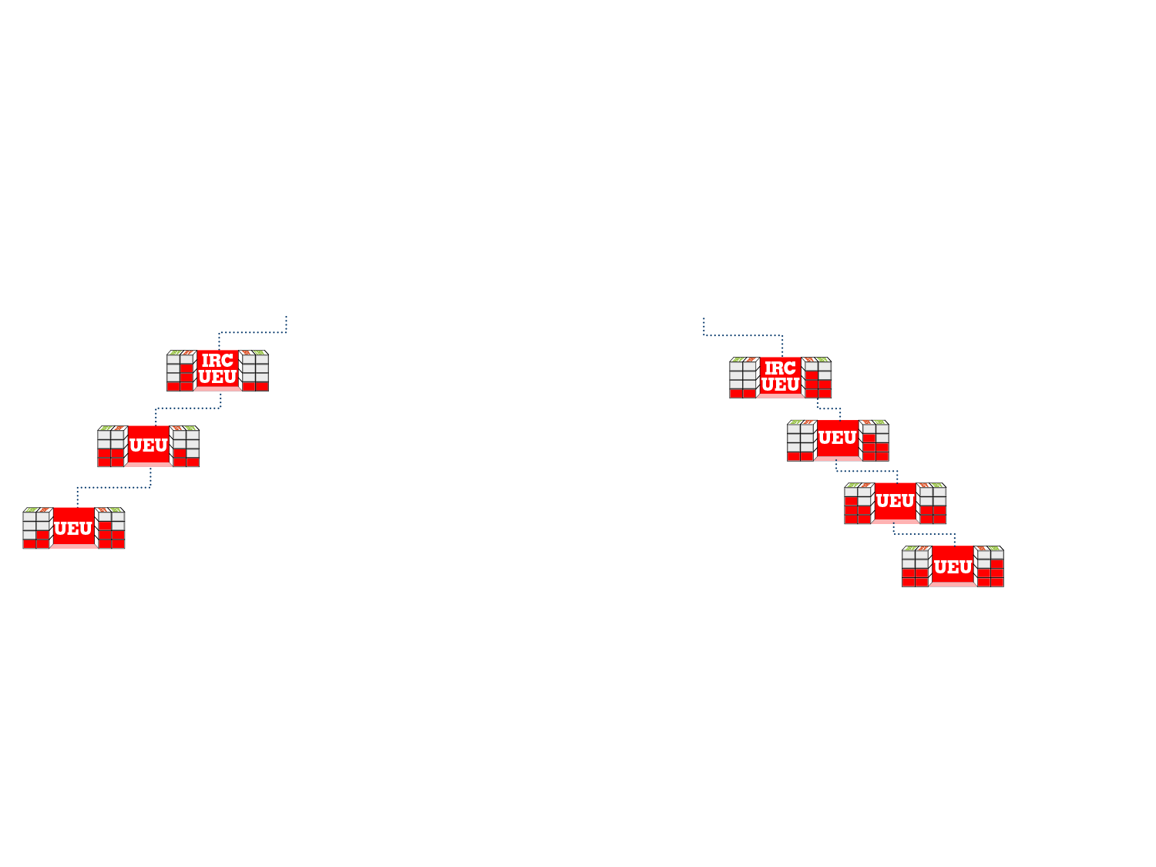
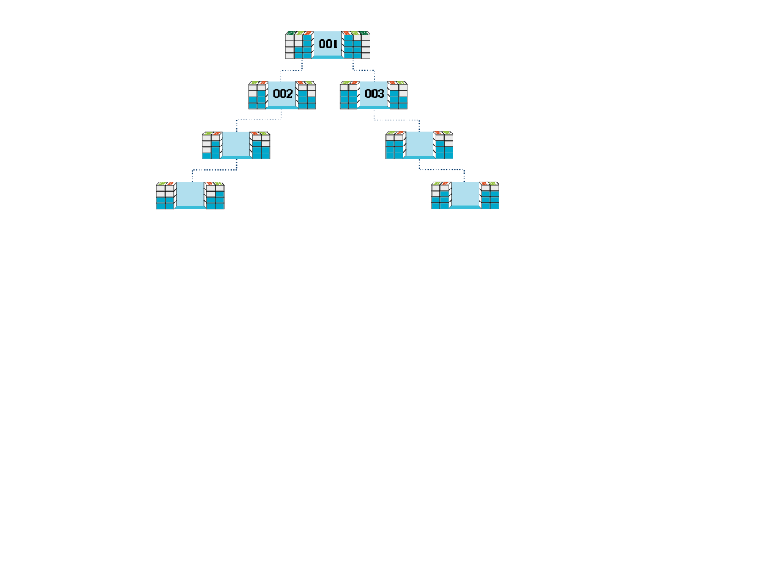
1400 BV
1,200 BV ($375 UGC Commission)
≥5,000 Previous Balance
1,200
1,200
≥5,000 Previous Balance
1,400
1,200
Each BDC must have accrued 1,200 BV/1,200 BV in “Home Region” volume* (one time) for that BDC to be eligible to earn UGC commissions from the excess converted “Expanded Region” BV.
*(Converted “Expanded Region” BV Does Not Count)

