Slide 1
Path to Market America Million Dollar Club
Liyen Ho

Slide 2
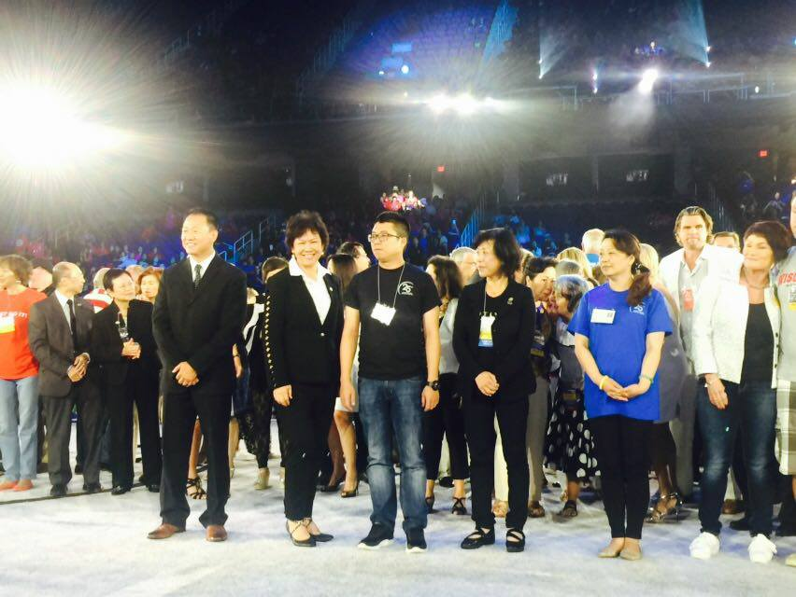
Sharing my journey

Slide 3
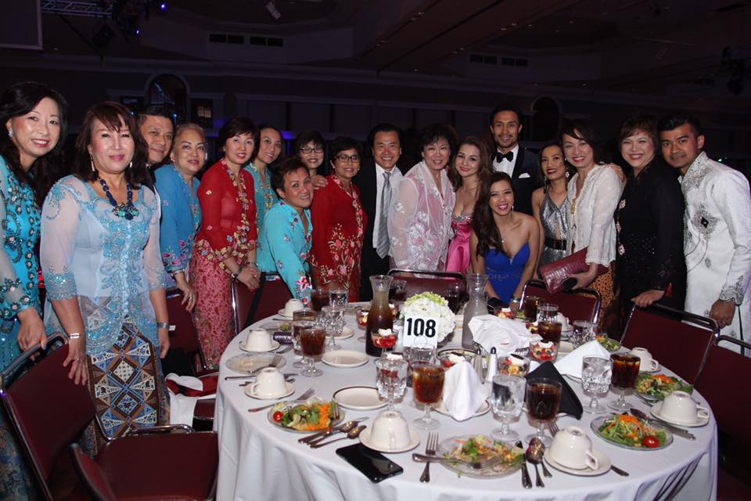
Sharing our fun times

Slide 4
Where all learning begins…

Slide 5
Where belief is planted…

Slide 6
Sydney Australia

Slide 8
What I learned along the way…
PRESENTED BY LIYEN HO

Slide 9
All about Attitude
The first fundamental in every aspect of life…

Slide 10
Plan Ahead
Envision and Dream
Plan and conceptualize
Build it before you need it
PRESENTED BY LIYEN HO

Slide 11
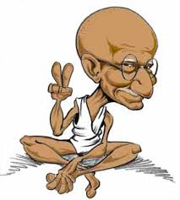
Be Positive
“Keep your words positive, because your words become your behaviours. Keep your behaviours positive, because your behaviours become your habits. Keep your habits positive, because your habits become your values. Keep your values positive, because your values become your destiny.”
– Gandhi

Slide 12
Winners never quit, quitters never win!
The seeds
and the wind
Opposition starts from the word go…
All trying to find out how determined you are
How strong are you!
What’s your WHY?

Slide 13
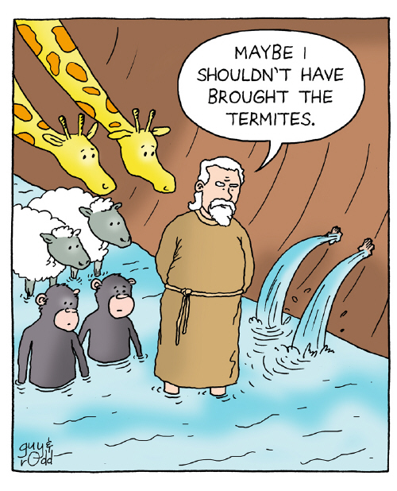
Don’t Listen To The Critics
Poor Noah must have been a
laughing stock …
120 years before floods started
No water around to float it
7 days inside the Ark before rains came
Rained for 40 days and 40 nights
Earth flooded for 6 months

Slide 14
Don’t watch and wish; get to work !
Anything worth
achieving demands sacrifice….
What are your sacrifices?
Remember your priorities
PRESENTED BY LIYEN HO

Slide 15
A little progress each day adds up…
Never be afraid to try new things
Be prepared to learn
Start small….
PRESENTED BY LIYEN HO

Slide 16
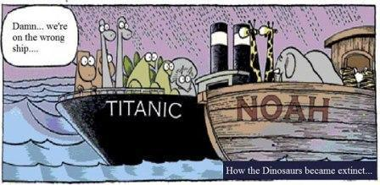
Be coachable…
The Ark was built by amateurs; the Titanic by professionals

Slide 17
Two by Two
Magic in Power of Two
Select your two leaders (builders) carefully, right from the start
Look for the gold, not the dirt – Andrew Carnegie
PRESENTED BY LIYEN HO

Slide 18
We’re In The Same Boat
Selection of the right partners is key
Importance of narrowing one’s focus to the real priority
Focusing on star talents, and those committed to work the business

Slide 19
Build Your Future on High Ground
Stick out for what’s right
Stay true to your ideals
Don’t stoop and succumb to others
Take courage to stand up for what’s right
Don’t worry about those who talk behind your backs; they are behind you for a reason.
PRESENTED BY LIYEN HO

Slide 20
United we stand, divided we fall!
Stay away from those who sow discord
Celebrate differences

Slide 21
Just get the job done!
Have faith in your leaders
Plan, strategize, work hard
Stay on course!

Slide 22
Love what you do Do what you love
Surround yourself with fun people
Enjoy the people
Enjoy the journey!

Slide 24
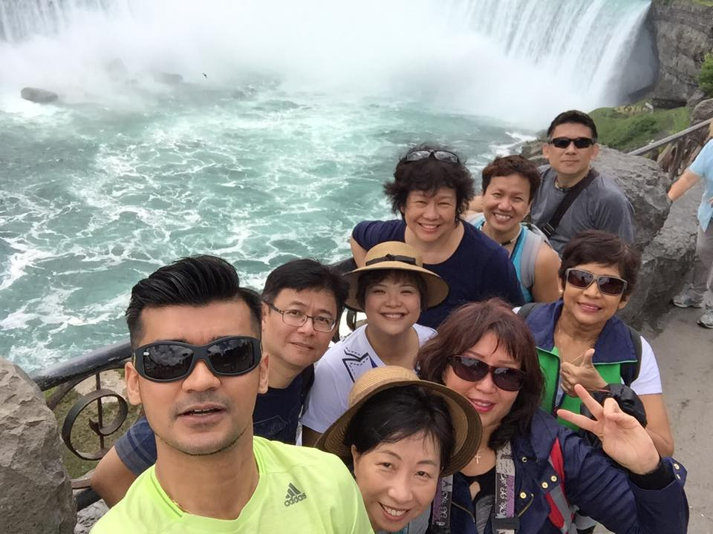
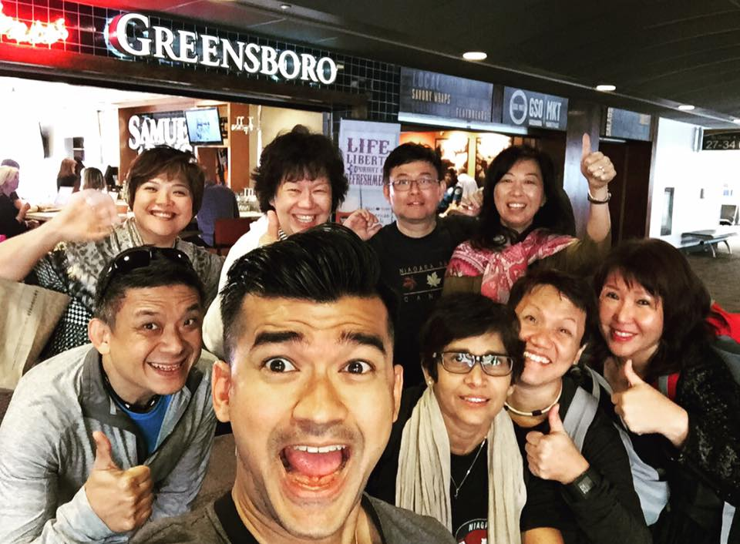

Slide 25
Stay Fit
Be around to enjoy your residual income!
Don’t let others enjoy for you !

Slide 26
Life long learning
Use your tools,
prepare them for use
Feed your mind
Knowledge is power
Education is a reservoir

Slide 27
Everyone wants the rainbow, but don’t want the rain

Slide 28
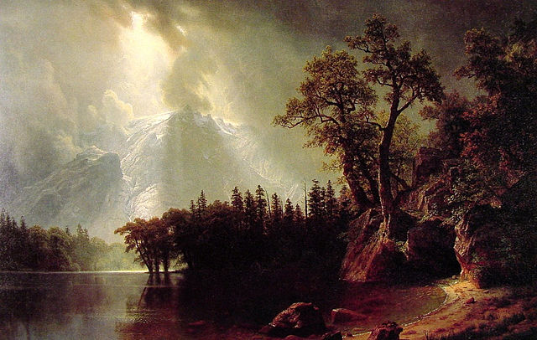
The Storm Will Pass
Learn from the mistakes, and move on
Bad flushes and purges happen for a reason
“When it comes to making mistakes, bounce back, don’t fall down.” Richard Branson

Slide 30
Attitude of Gratitude
Give thanks, it changes perspective
Be grateful for those who paved the way for us

Slide 31
Market Australia thank you

Slide 34
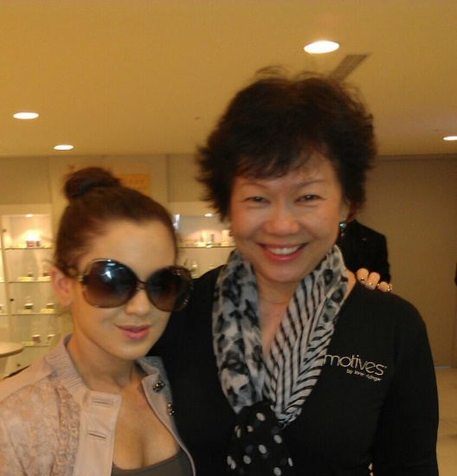
That Fateful Day

Slide 35
Launch of Market Singapore

Slide 36
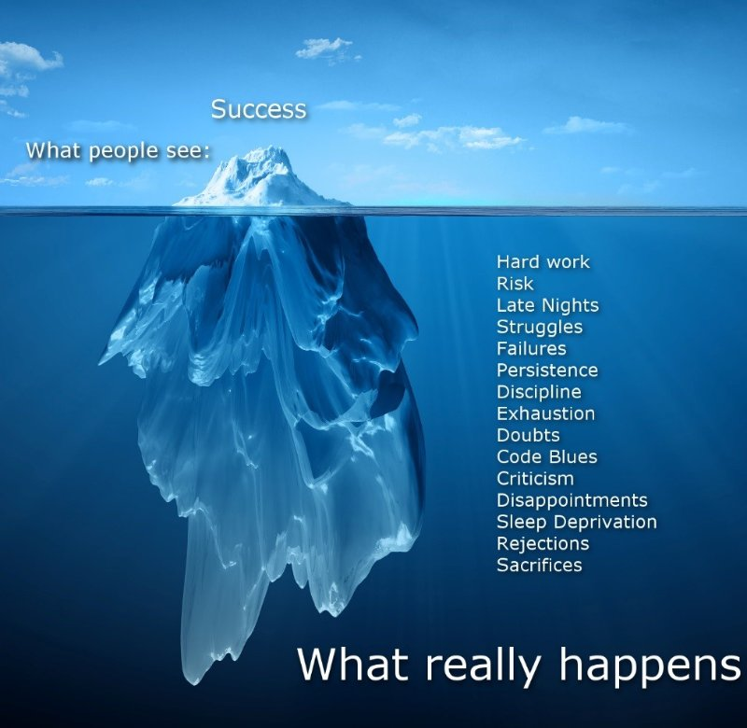

Slide 37
The Time is Now
Live in the Present
Never leave till tomorrow what you can do today – Benjamin Franklin
Seize the Moment

Slide 38
Ride The Boat
Ride on our proven vessel of success
Pay the price of entrepreneurship
Do what it takes to get there

Slide 39
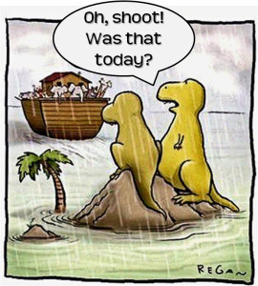
Don’t Miss The Boat
The best time to build is
NOW!
PRESENTED BY LIYEN HO

