Slide 1
New UnFranchise® Owner Training

Slide 2
The income levels mentioned in the following presentation are for illustration purposes only. They are not intended to represent the income of a typical Market America UnFranchise® Owner, nor are they intended to represent that any given UnFranchise Owner will earn income in that amount. The success of any Market America UnFranchise Owner will depend upon the amount of hard work, talent, and dedication which he or she devotes to building his or her Market America Business.

Slide 3
Acronyms
UFO –
PC –
BV –
IBV –
BDC –
IBDC –
MPCP –
SABP –
UnFranchise® Owner
Preferred Customer
Business Volume
Internet Business Volume
Business Development Center
Internet Business Development Center
Management Performance Compensation Plan
Shopping Annuity Bonus Pool
UFMS –
NMTSS –
NUOT –
B5 –
ECCT –
HBP –
UBP –
UnFranchise Management System
National Meeting, Training and Seminar System
New UnFranchise Owner Training
Basic 5
Executive Coordinator Certification Training
Home Business Presentation
UnFranchise Business Presentation (NMTSS approved meeting)

Slide 4
Three Required Trainings
New UnFranchise® Owner Training (NUOT)
Basic Five (B5)
Executive Coordinator Certification Training (ECCT)
Terminology and requirements
The fundamentals of building an UnFranchise business
In depth knowledge of terminology and requirements
In depth knowledge of policy and procedures
NUOT and B5 are available in the UnFranchise Business Account > Help & Training > Online Training

Slide 5
Continuing Education
Should these trainings be repeated?
When should they be repeated?
Are there other suggested trainings?
Yes, ongoing training is critical for success
Attend with your new team members
At least quarterly as recommended by the Master UFO program
University specific trainings, Locals, Districts, Regionals and Major Events

Slide 6
Funding Overhead Expenses
10 customers ordering 35 € monthly = 350 €= 23 € profit/month
Example: Optimal Wellness Kit, SRP 80,75 €, profit 23 €

Slide 7
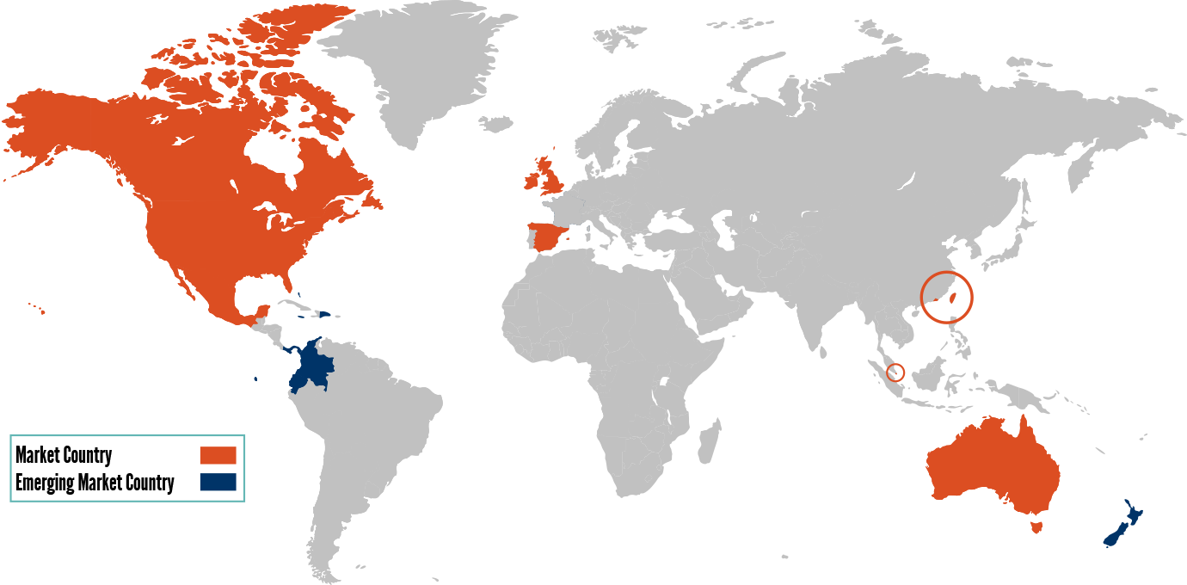
Americas
Europe
Asia Pacific
Fully operating in nine countries, with seven Emerging Market countries and servicing over 200 countries through Global.SHOP.COM
Countries listed in Notes
Notes:
United States, Canada, Mexico, Bahamas, Columbia, Dominican Republic, Ecuador, Panama, Jamaica
United Kingdom, Spain
Australia, Taiwan, Hong Kong, Singapore, New Zealand

Slide 8
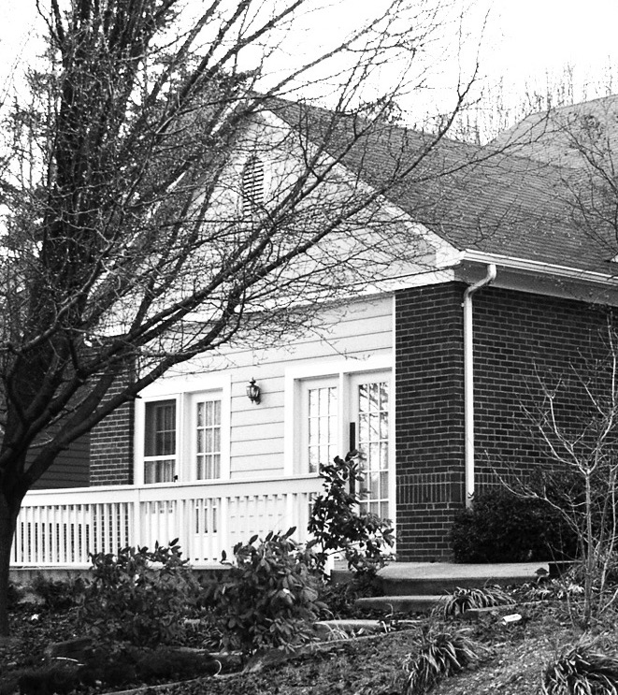
FOUNDED
IN 1992
TODAY
A Global Product Brokerage and Internet Marketing Company
Specializing in One-to-One Marketing and creating a Shopping Annuity®
Greensboro, NC

Slide 9
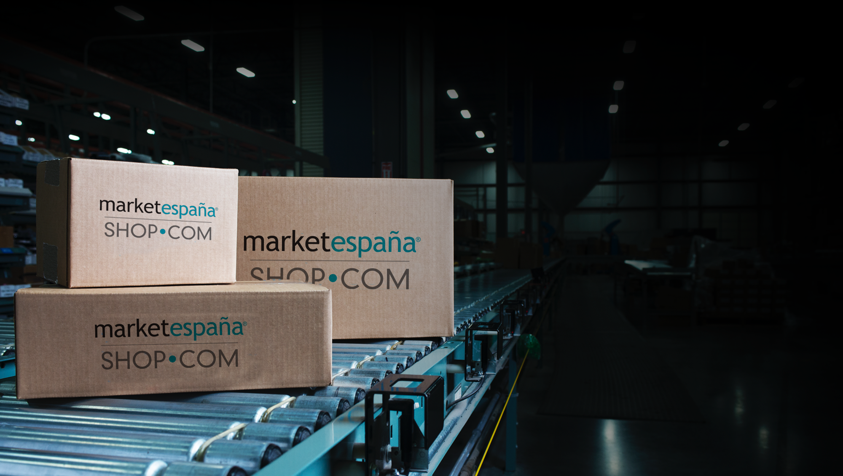
Market America Brands
A PRODUCT BROKERAGE COMPANY:
Hundreds of exclusive products and services
Does not rely solely on the sales of any one product or service
Access to multibillion dollar markets
Identifies the latest market driven products
Eliminates the burden of manufacturing
Partner Brands
Over 3000 Partner Stores and more than 40 million products
Popular online retailers

Slide 10
AN INTERNET MARKETING COMPANY
Hundreds of partner stores with thousands of products
Hundreds of exclusive Market Australia brands
Cashback on purchases and referrals
Comparative shopping
Hot Deals and Price Alert
Ranked
64

Slide 11
Provides the power of social
media and online shopping
Combines high-tech with high-touch
Offers the ability to reach
millions of customers
One-to-One Marketing and Social Shopping
Matches people to products
and products to people

Slide 12
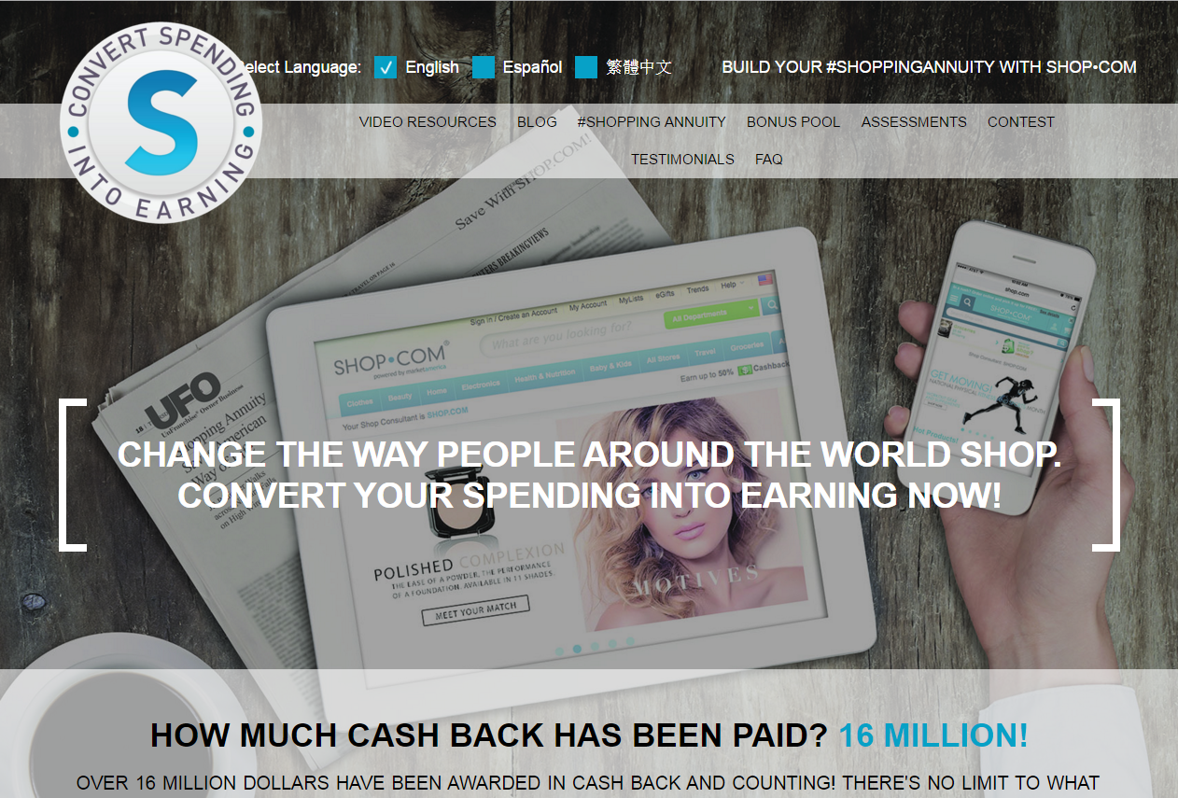
www.ShoppingAnnuity.com
TRADITIONAL ANNUITY
You must have discretionary income to make fixed sum payments which fund your annuity.
SHOPPING ANNUITY® By redirecting money you are already spending to SHOP.COM, you create your “fixed sum payment” to fund your Shopping Annuity.

Slide 13
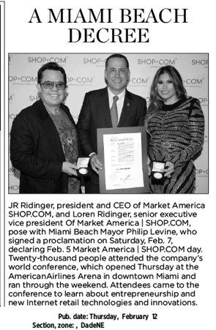
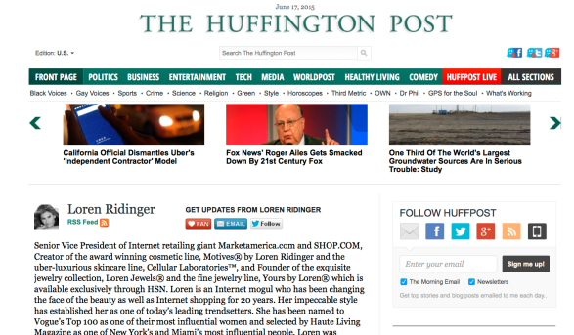
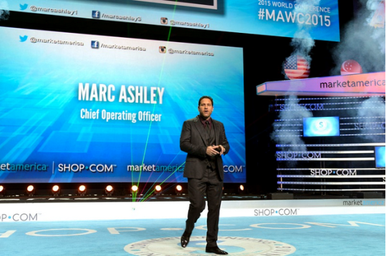
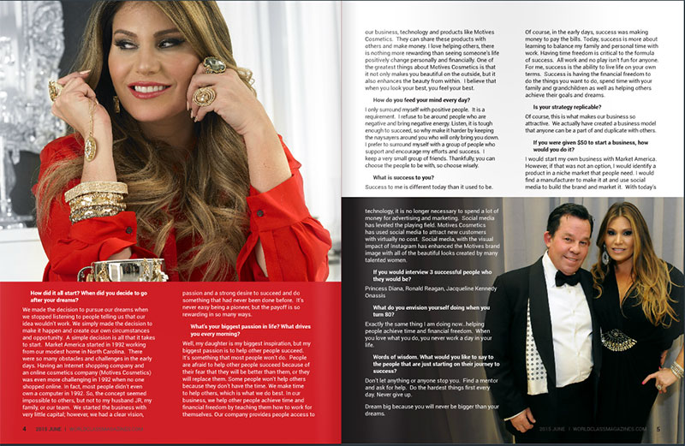
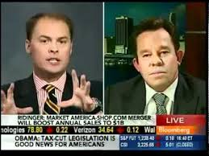
In the News
2013 Torch ]Award Winner Trust • Performance • Integrity BBB of Central NC

Slide 14
Business Tools and Websites

Slide 15
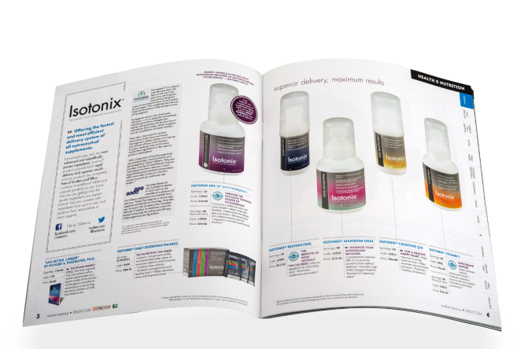
Flip Chart
Product Catalog
Code EU700
Code EU669
pkg of 10, 33,50 €
pkg of 5, 12,75 €

Slide 16
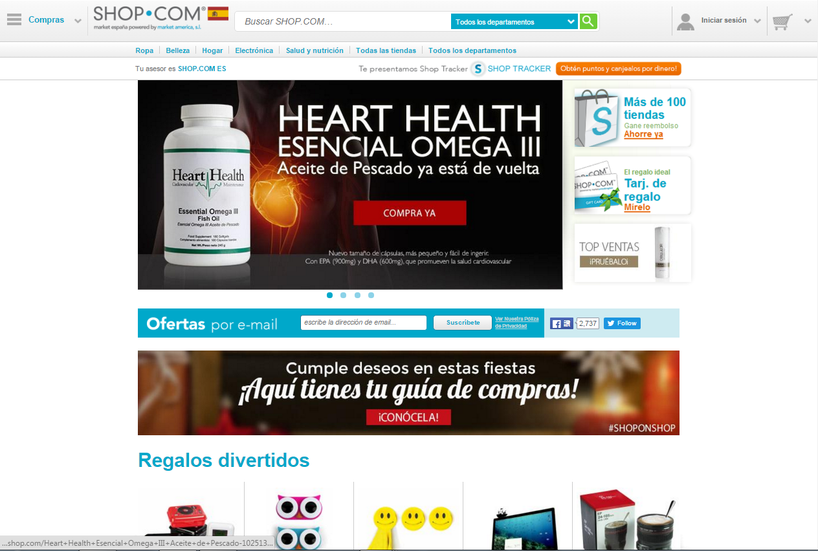
ES.SHOP.COM/yoursitename

Slide 17
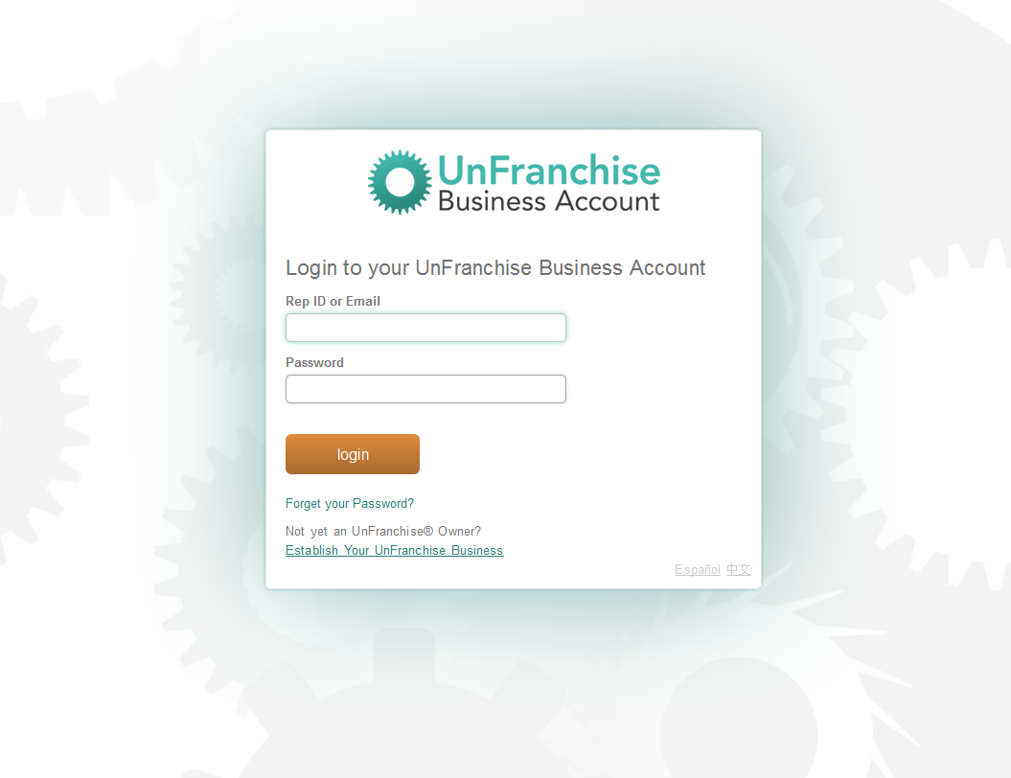
www.UnFranchise.com
Login

Slide 18
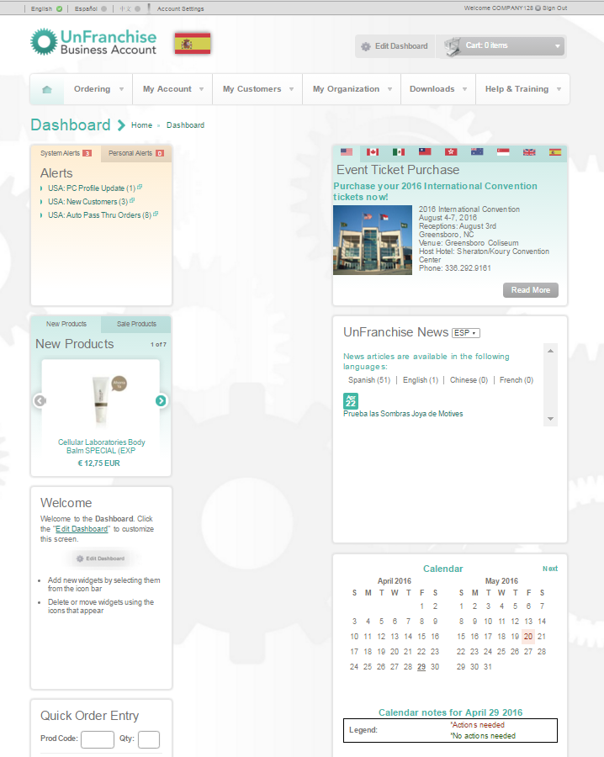
It is the UnFranchise Owner only website that provides all of the tools necessary to measure, monitor, adjust and control your business. Account information, company contact information, customer data, product ordering, management reports, forms, marketing tools, help and training, and much more are found on the UnFranchise Business Account.
Rep ID or email and password are required to login to the UnFranchise Business Account.
The UnFranchise® Business Account
(Back Office)

Slide 19
Be sure to enter this information in your phone so you will always have it with you:
UnFranchise® ID
Rep ID and login information
Personal PC ES.SHOP.COM login information

Slide 20
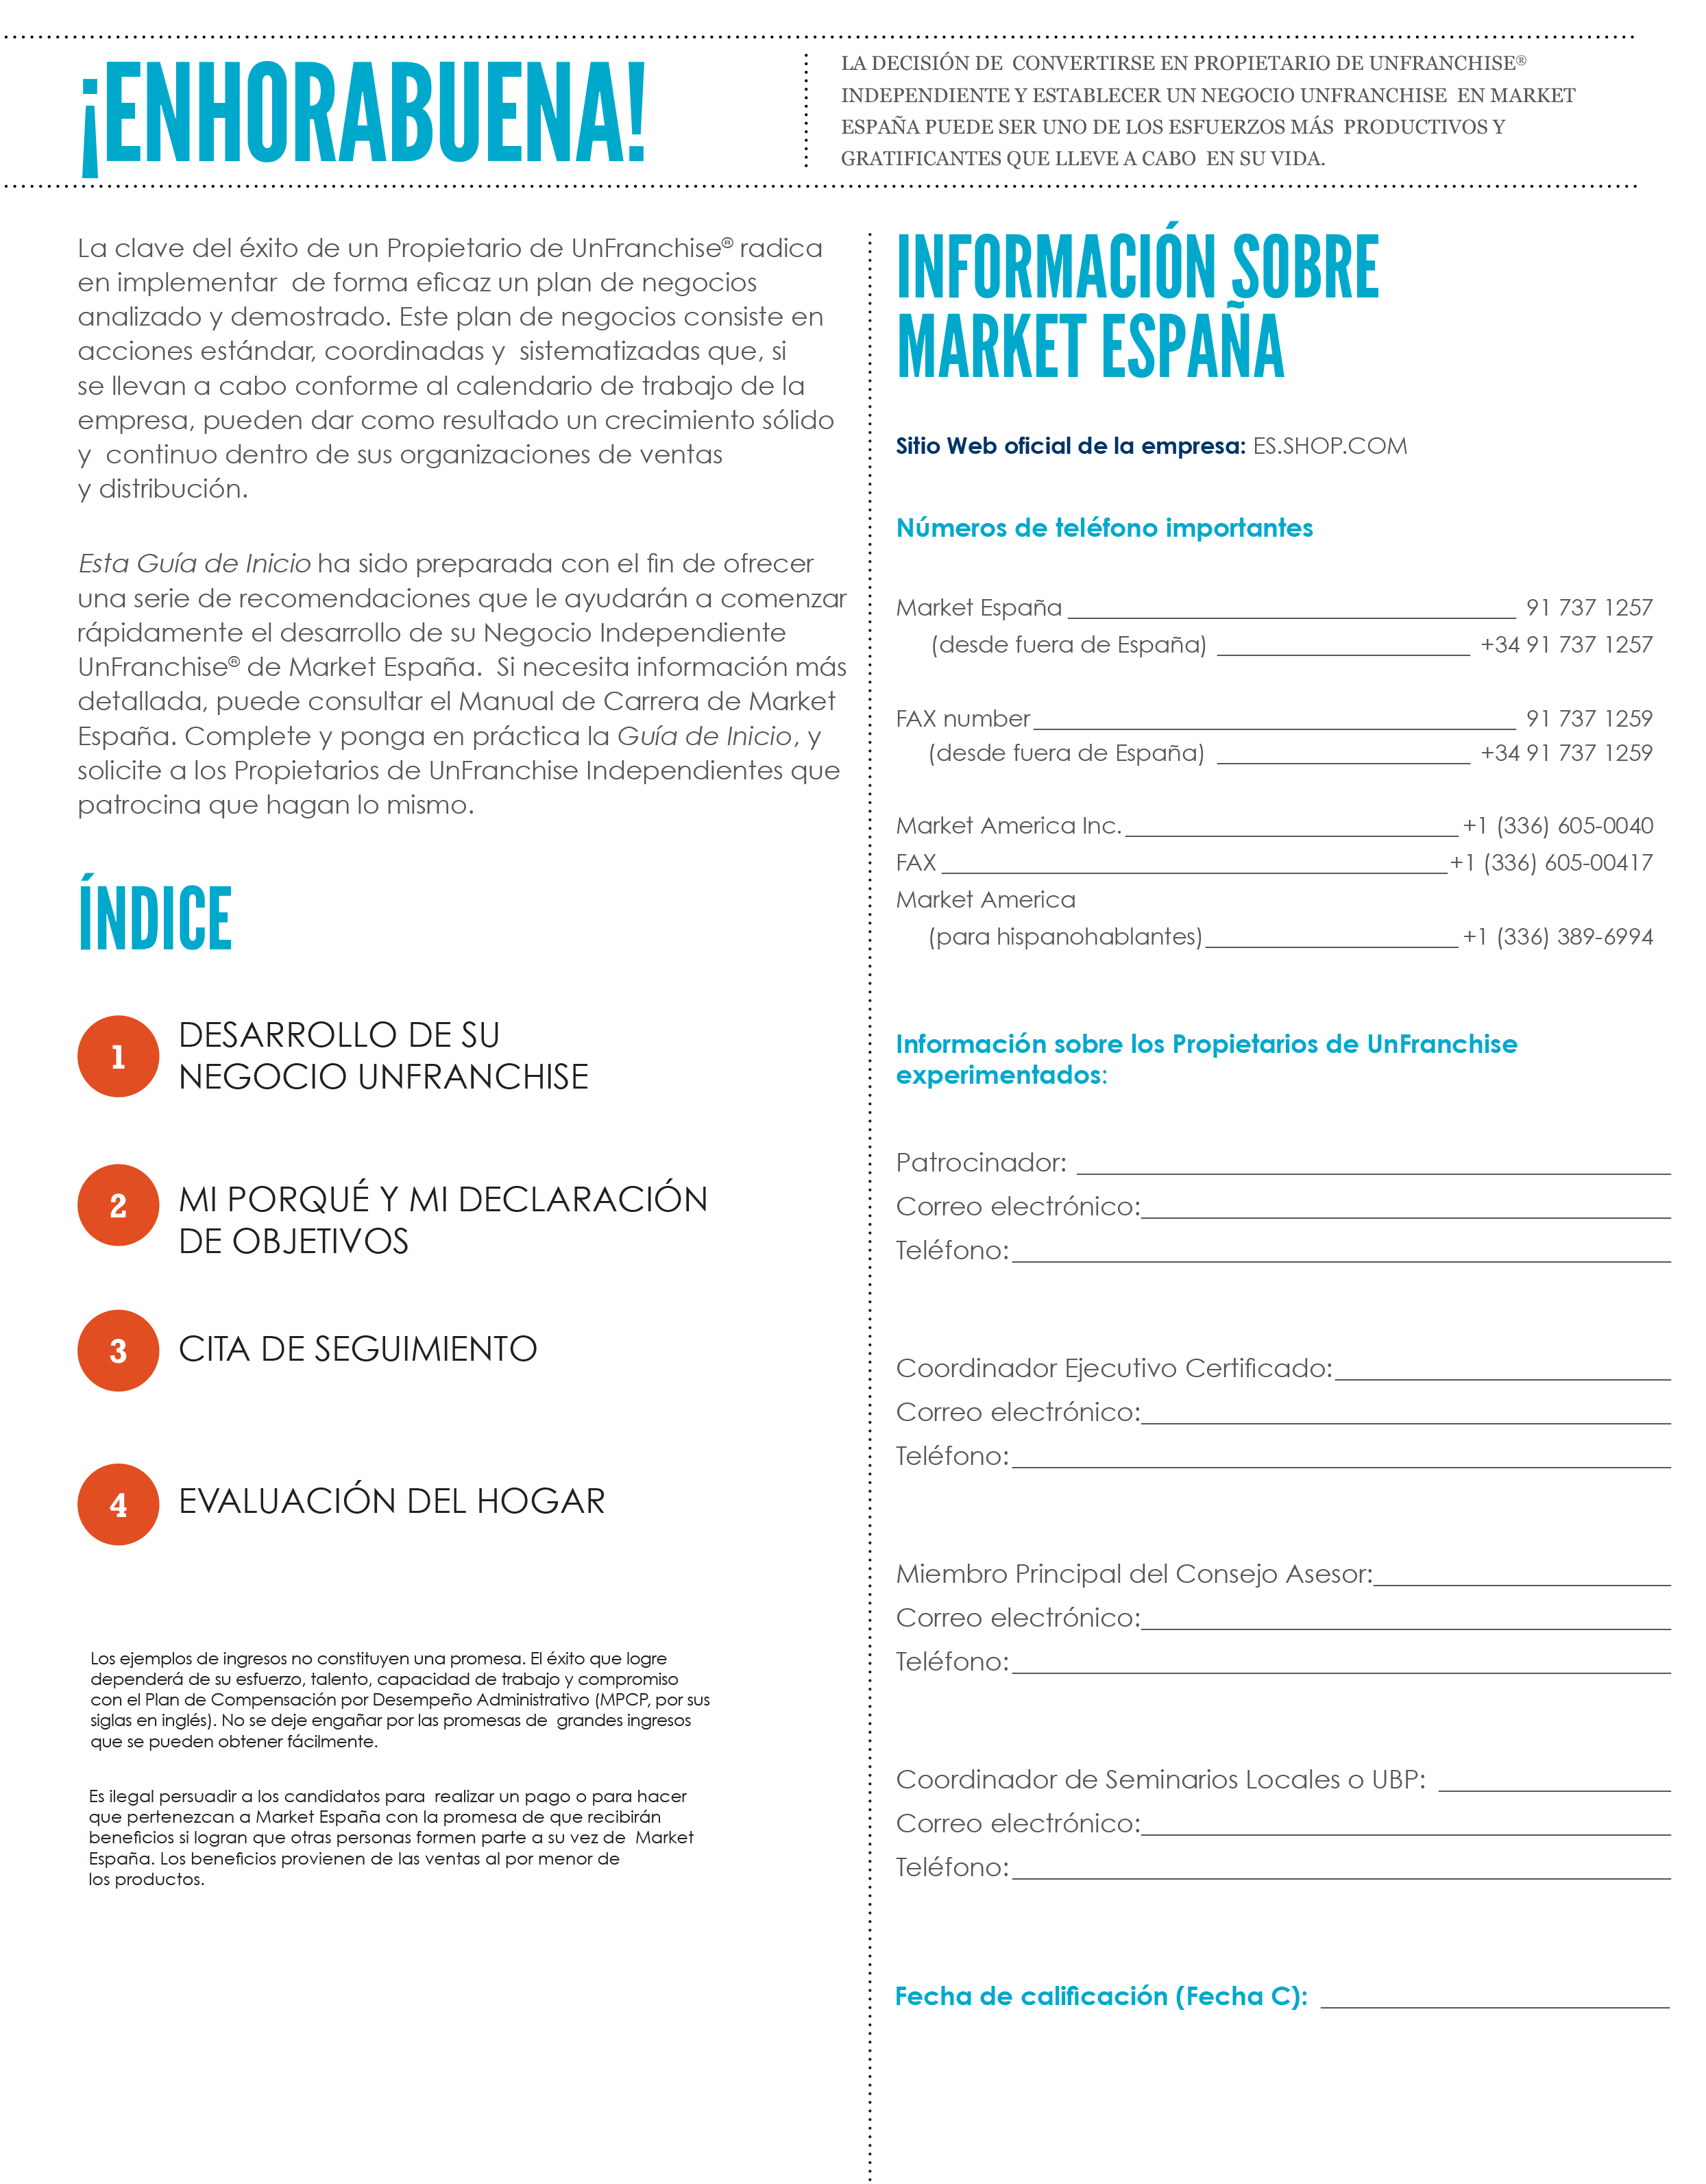
Getting Started Guide

Slide 21
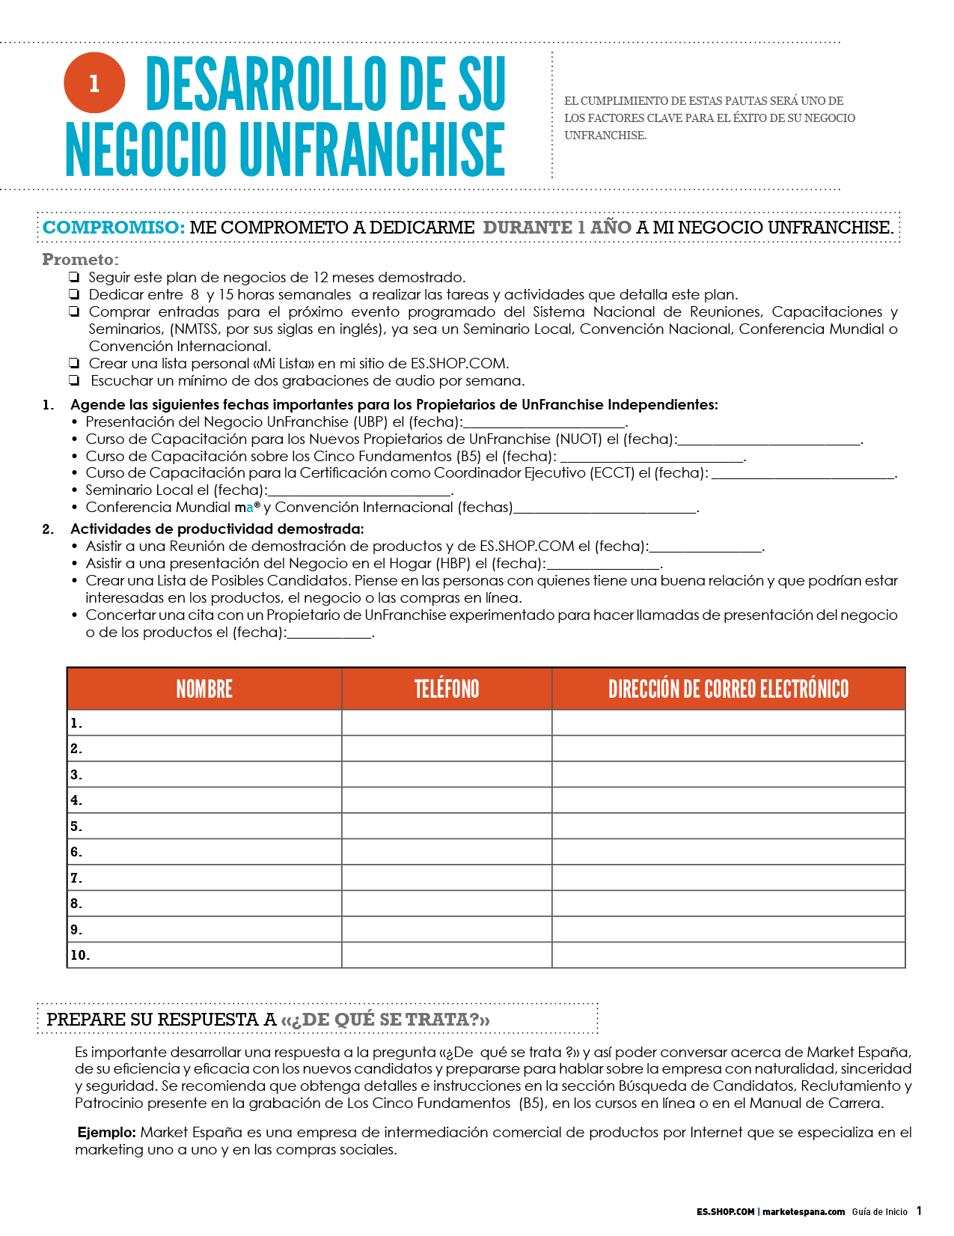
Notes:
I didn’t find the UFO Booklet

Slide 22
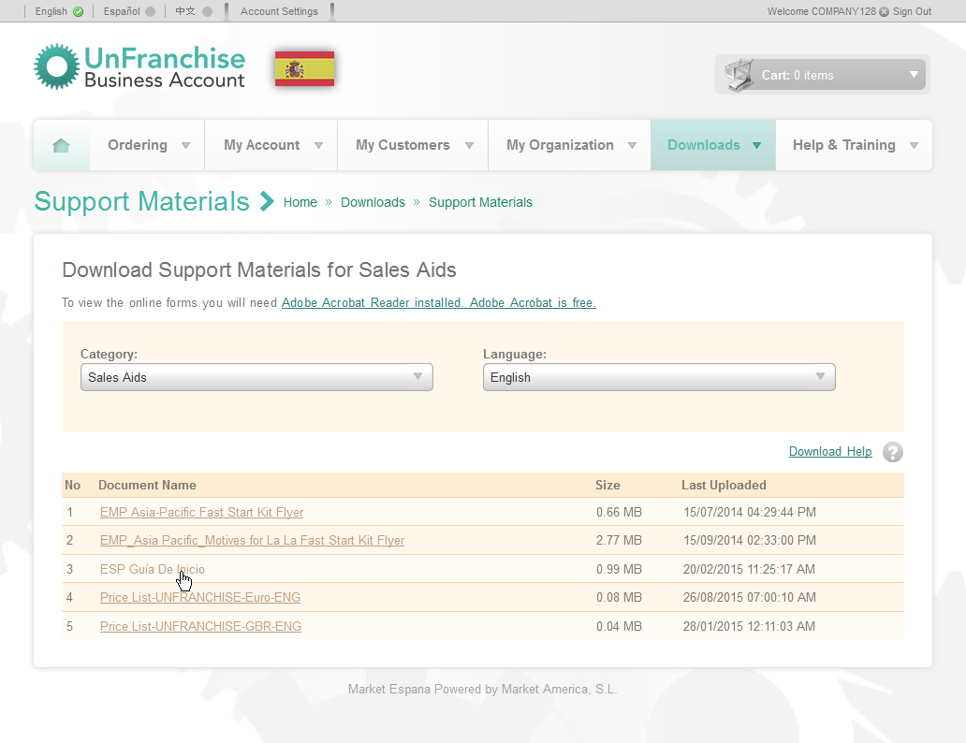
Getting Started Guide

Slide 23
Master unfranchise® owner program
A Structured System of Success for
Independent UnFranchise Owners

Slide 24
A comprehensive assessment of how well you and your sales organization are implementing the fundamental business practices.
The Basic 5
Diagnostic Test

Slide 25
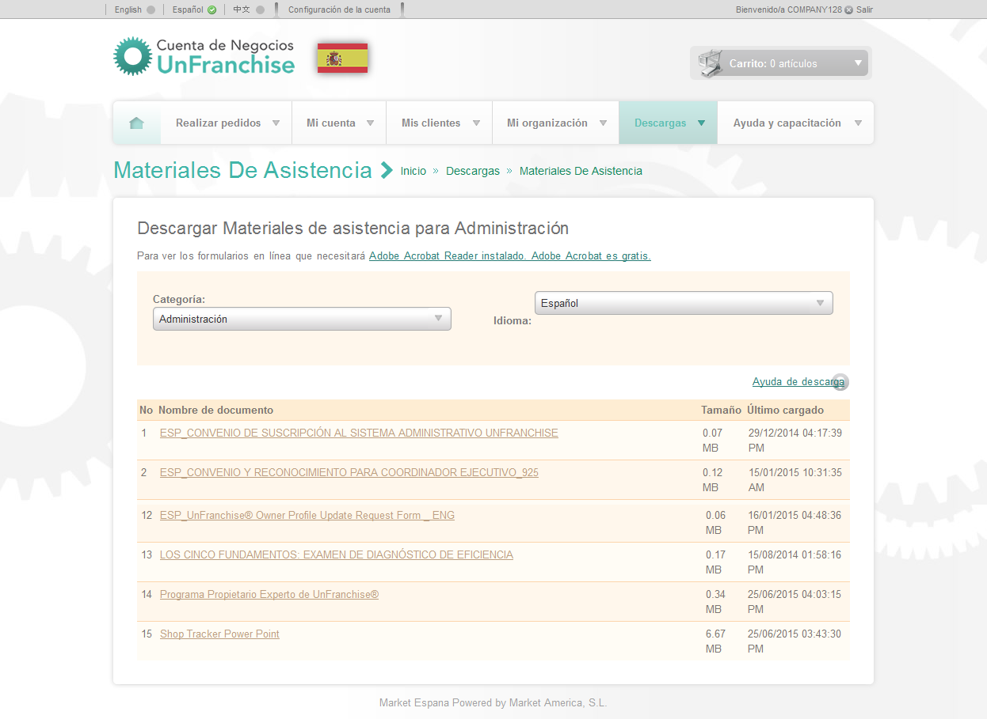
Master UFO Program
and
Basic 5 Diagnostic Test

Slide 26
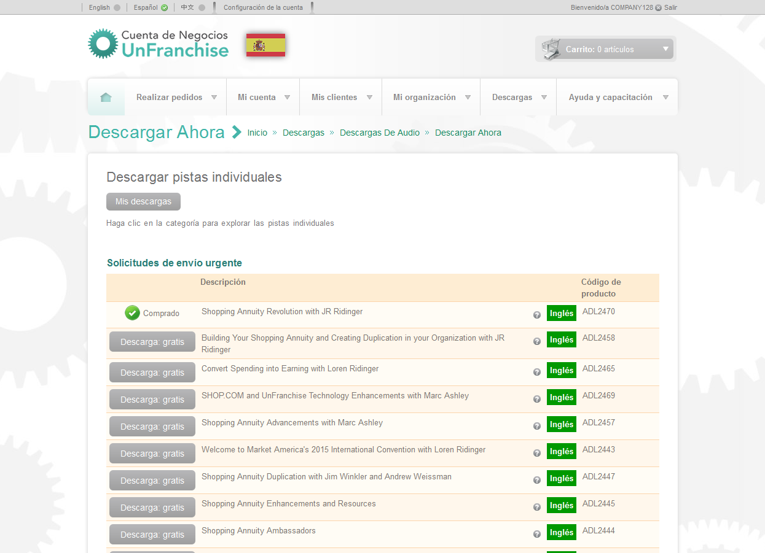
Audio Downloads

Slide 27
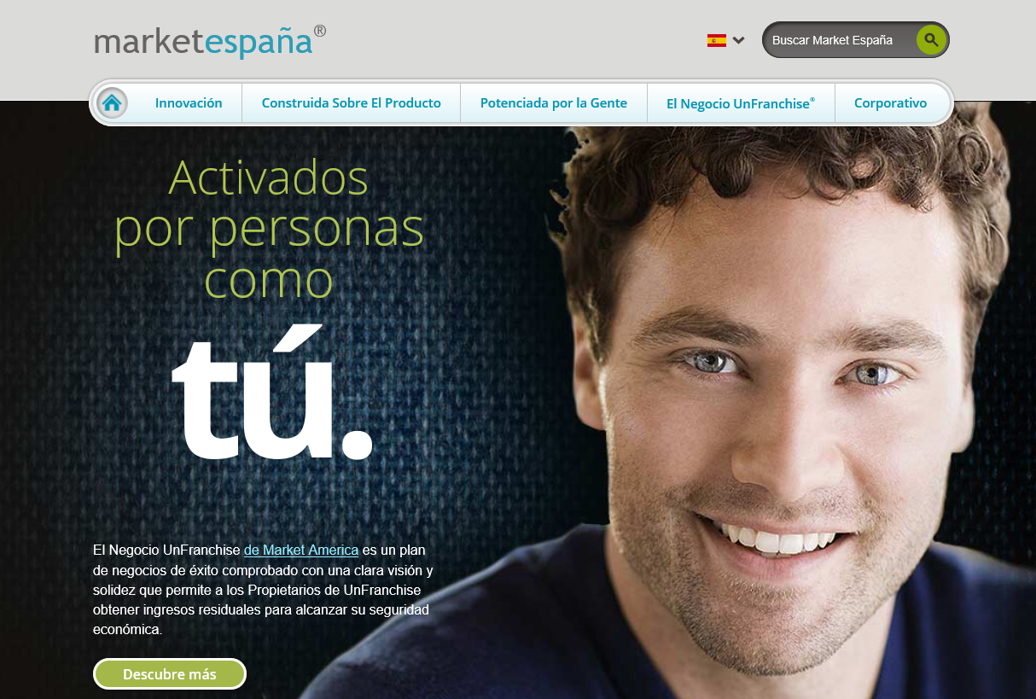
Marketespaña.com/nombredesusitio

Slide 28
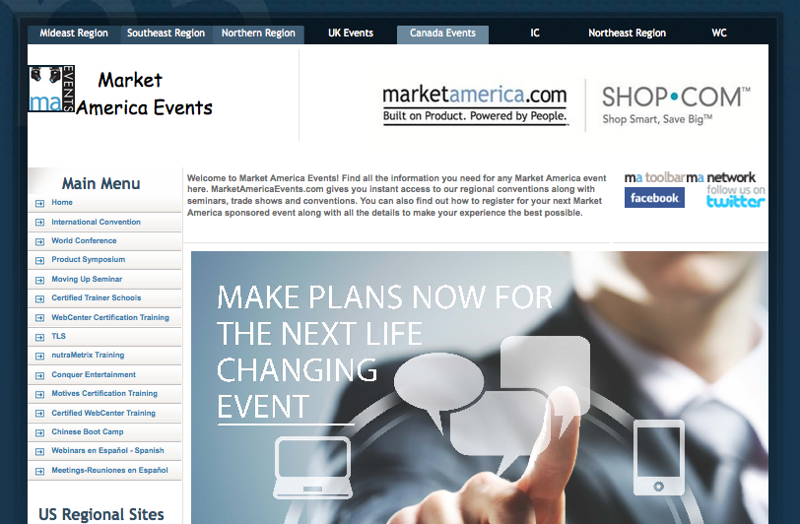
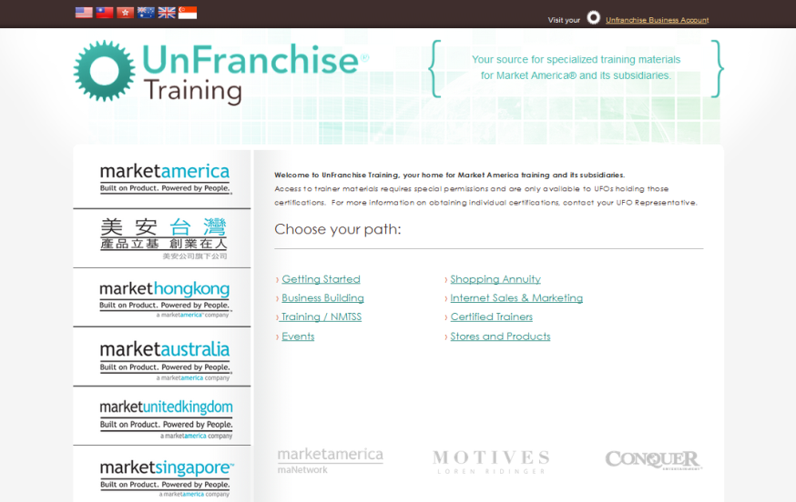
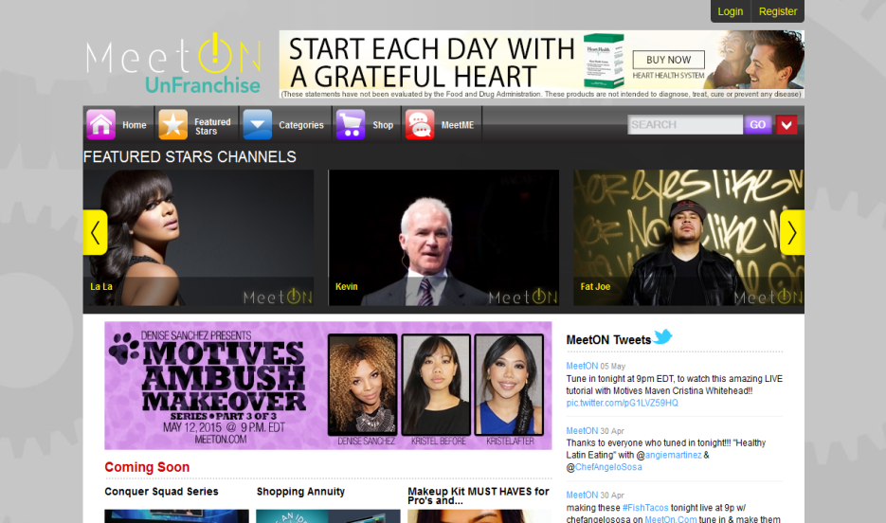
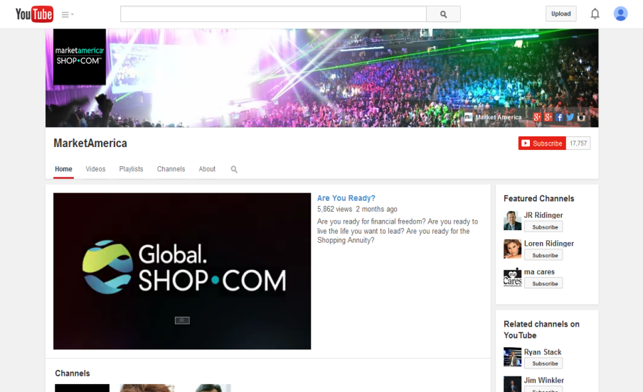
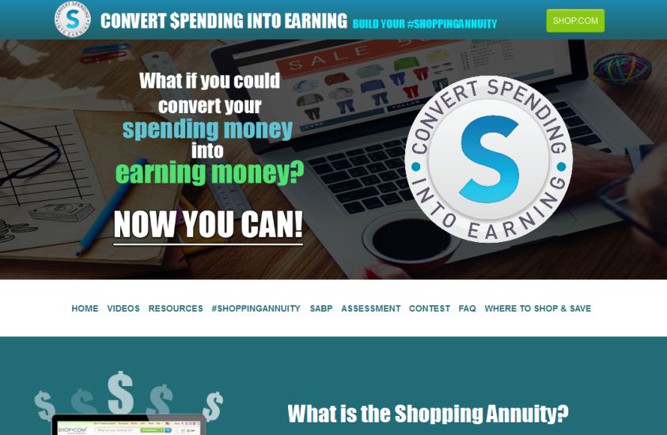
www.marketamericaevents.com
www.UnFranchiseTraining.com
UnFranchise.MeetOn.com
www.UnFranchiseManifesto.com
www.YouTube.com/MarketAmerica
www.shoppingannuity.com

Slide 29
Otros recursos en línea
WebCenter:
www.mawc411.com www.mawebcenters.com
Market España en Facebook
www.facebook.com/pages/Market-España/388524584662662?fref=ts

Slide 30
Key Terms and Definitions

Slide 31
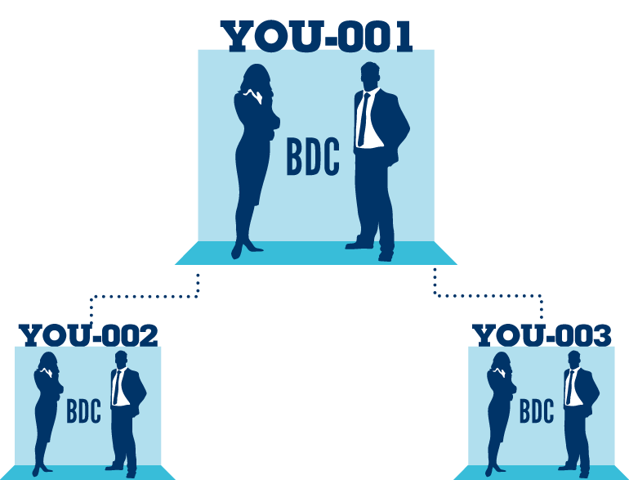
SALES REPRESENTATIVE
No cost
Buy product at UnFranchise® cost and earn gross retail profit
Have quarterly requirements
UNFRANCHISE® OWNER
Subscription Fee - 98,50 € (included in Fast Start Kit)
Buy product at UnFranchise cost and earn gross retail profit
Participate in the Management Performance Compensation Plan and earn commissions
Have quarterly requirements
*BDC - Business Development Center

Slide 32
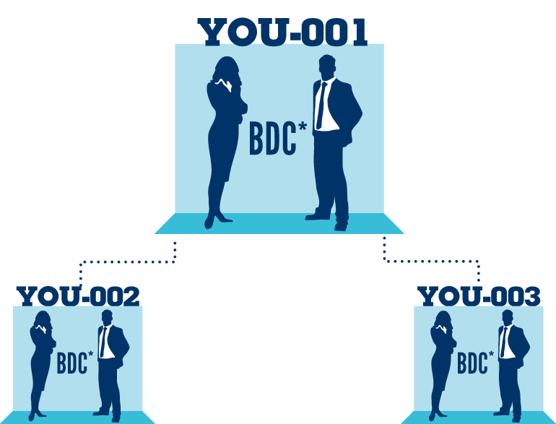
Business Development Center (BDC)
Your place of business in the Market America computer system
Identified by your nine digit UnFranchise® ID followed by a three digit extension
Example: 123456789-001
The BV and IBV banks are located here
123456789-001
123456789-002
123456789-003
*BDC - Business Development Center

Slide 33
Sponsor
Placement
The Independent UnFranchise Owner who introduced you to the business
Location of a BDC in the Market America genealogy
Specified on the application by the new UnFranchise Owner’s Sponsor
Can place volume in BDCs of personally sponsored UFOs who are enrolled correctly in UnFranchise AutoShip
Also referred to as linkage
Responsible for managing, supervising, training, and motivating within their organization
A BDC may only be placed on the left or right side of another BDC where no BDC currently exists (open placement)

Slide 34
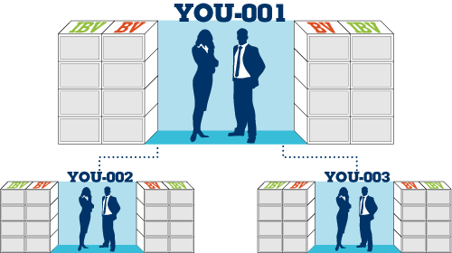
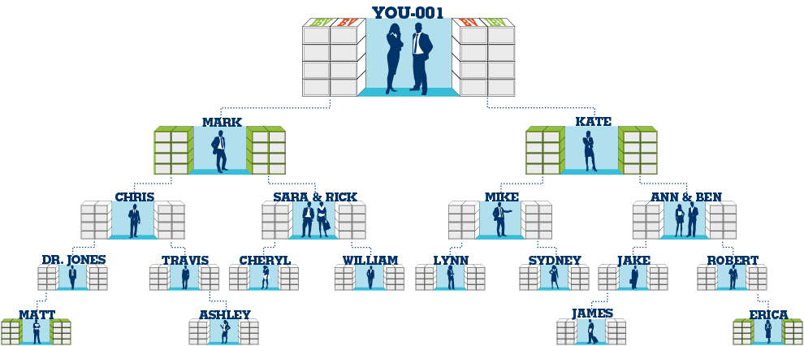
Sponsorship vs. Placement
All UFOs start with three BDCs (not shown on all diagrams)
Example: You personally sponsored Mark, Kate and Matt. Although Matt is personally sponsored by you, his placement is on the left side of Dr. Jones Business Development Center (002 left)

Slide 35
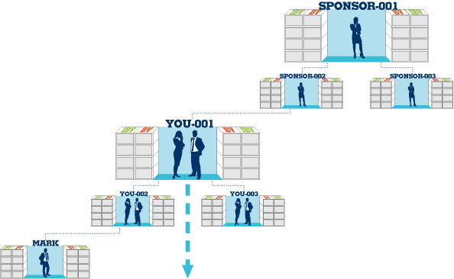
Common Leg – First Personally Sponsored UFO Placement Strategy
First personally sponsored UFO
If you are placed on the left, then your 002 left is your common leg and your first personally sponsored UFO should be placed on your left (002 left)
If you were placed on the right, then this would be reversed and your right side would be your common leg (003 right)
If another UFO has already been placed in your organization, then your new personally sponsored UFO should be placed at the bottom of that leg (002 left or 003 right)

Slide 36
Registration
There are two options to register an UnFranchise business online
New registering business partner and sponsor should both be present for either the Signup Wizard or Partner Now option
In person, screen share, Skype, phone

Slide 37
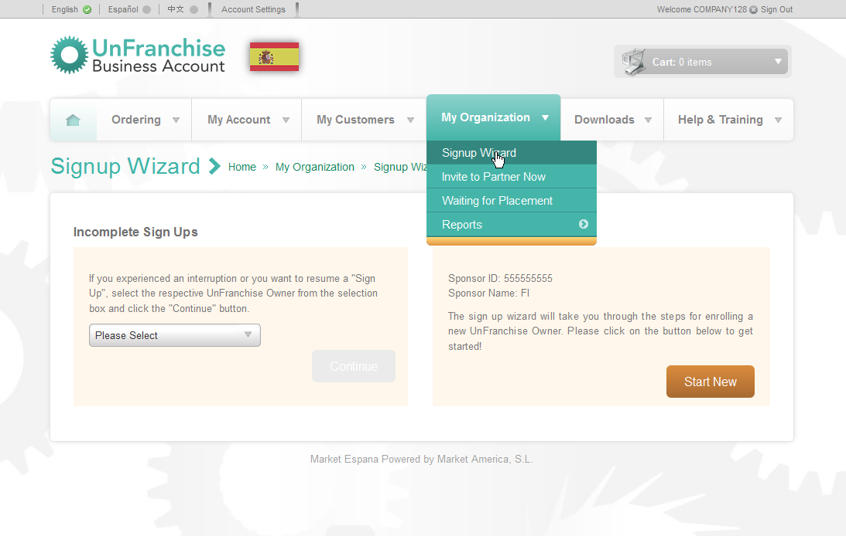
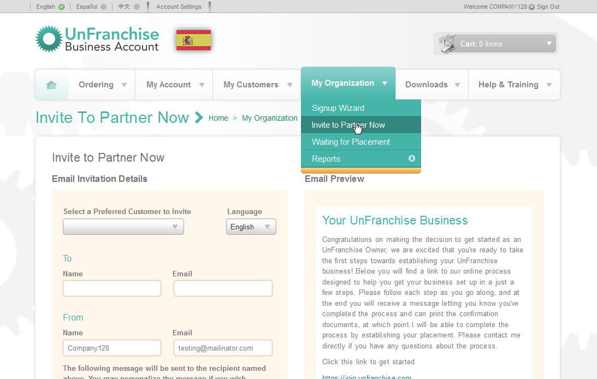
UnFranchise® Registration
Two ways to register an UnFranchise business
Signup Wizard
Invite to partner now

Slide 38
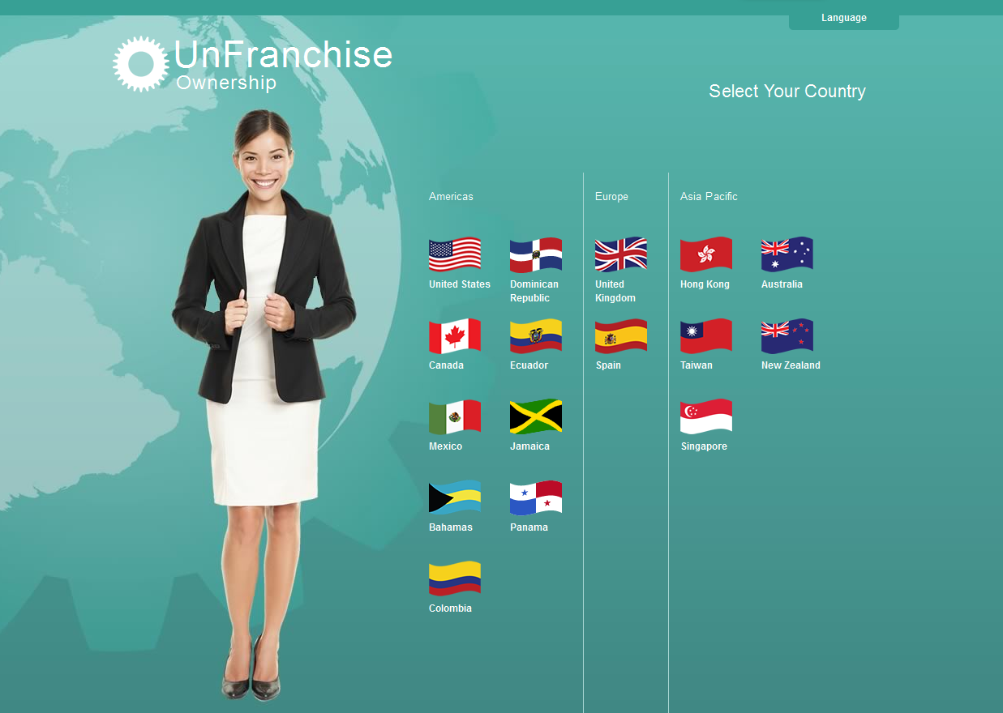
Select the country where your new business partner resides

Slide 39
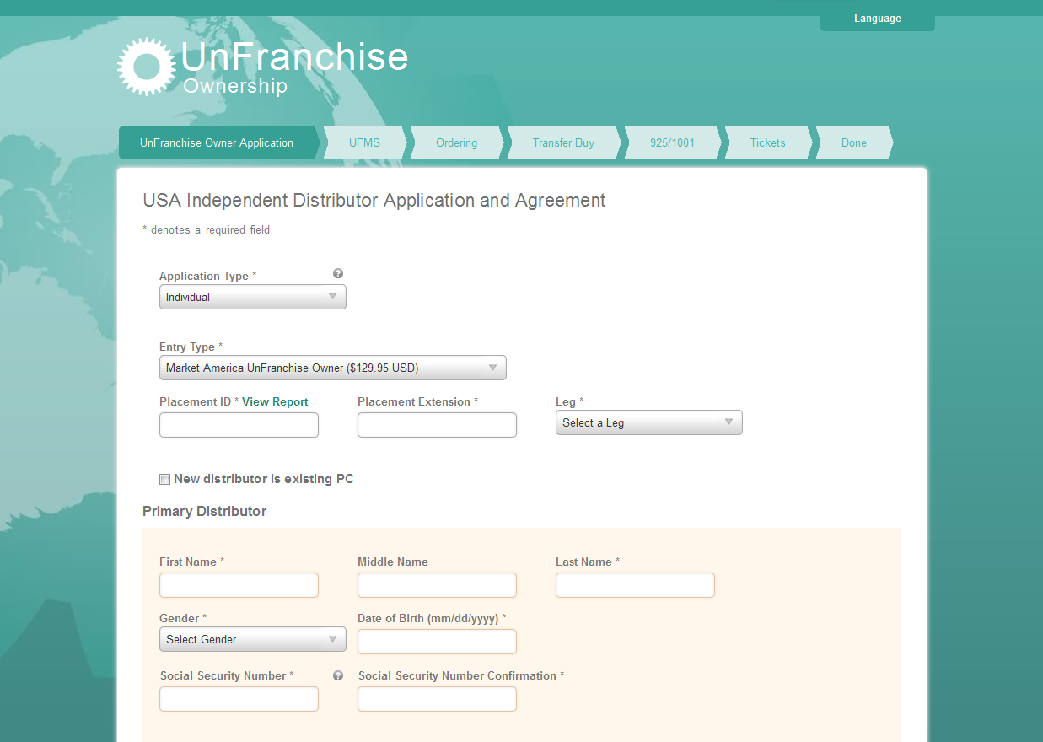
Prior to registration of a new business partner discuss placement information with a senior partner or sponsor

Slide 40
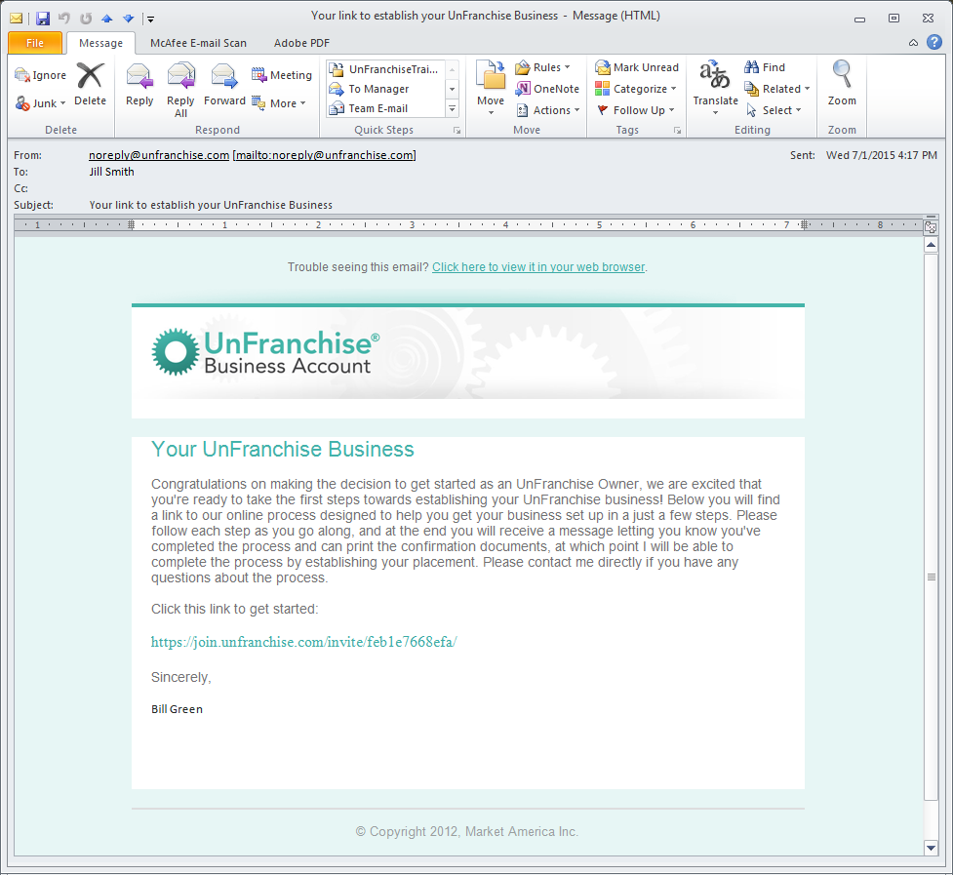
Let your prospect know to expect this email and follow up with a phone call

Slide 41
Fast Start Program
Purchase of a Fast Start Kit is required when using the Partner Now registration

Slide 42
Your Subscription Includes
UnFranchise® Business Account
UnFranchise® Owner Magazine
Personal and support websites
Training and seminar system
Career Manual and Getting Started Guide
Coaching and mentoring by experienced UnFranchise Owners

Slide 43
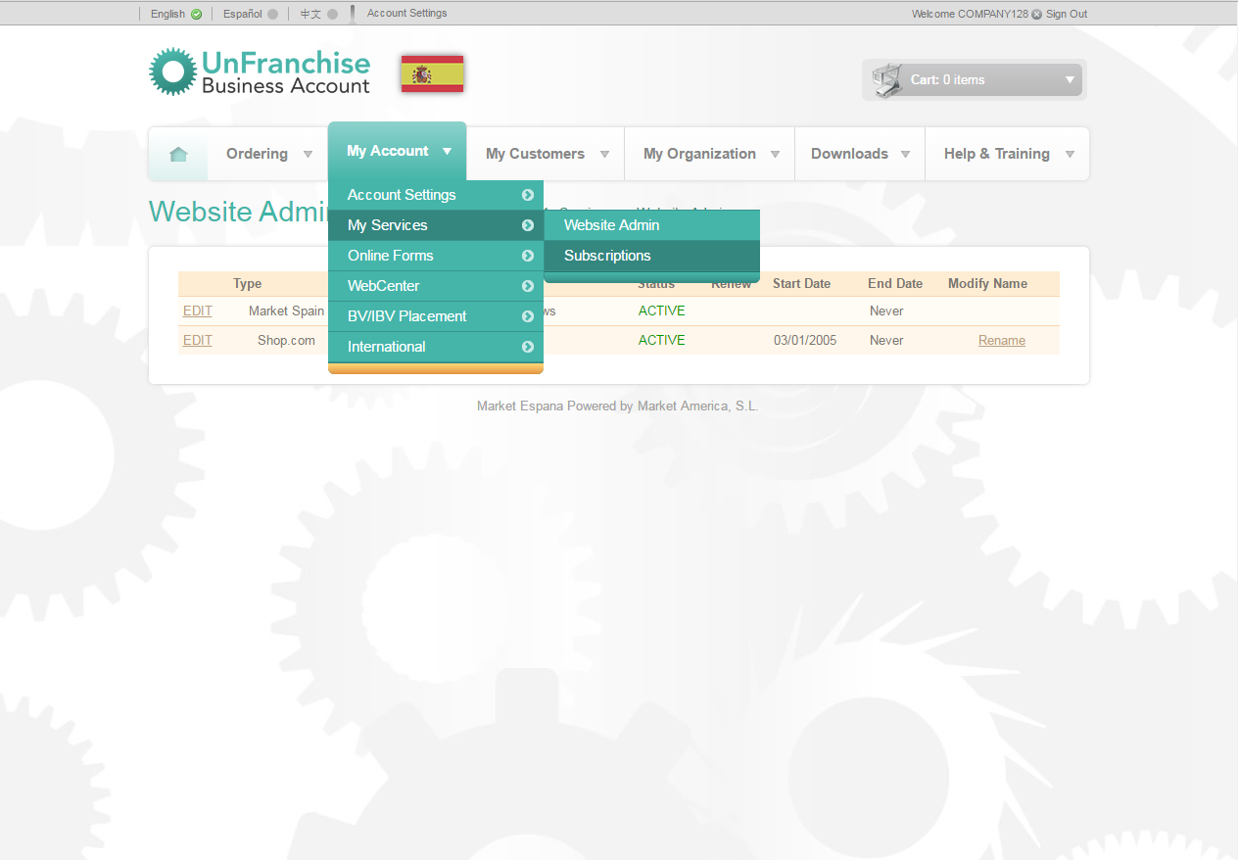
Guide your new business partner through setting up their SHOP.COM website
Tutorial videos explaining this process are available in Help & Training > Online Training > Course Catalog > Your UnFranchise® Business Account

Slide 44
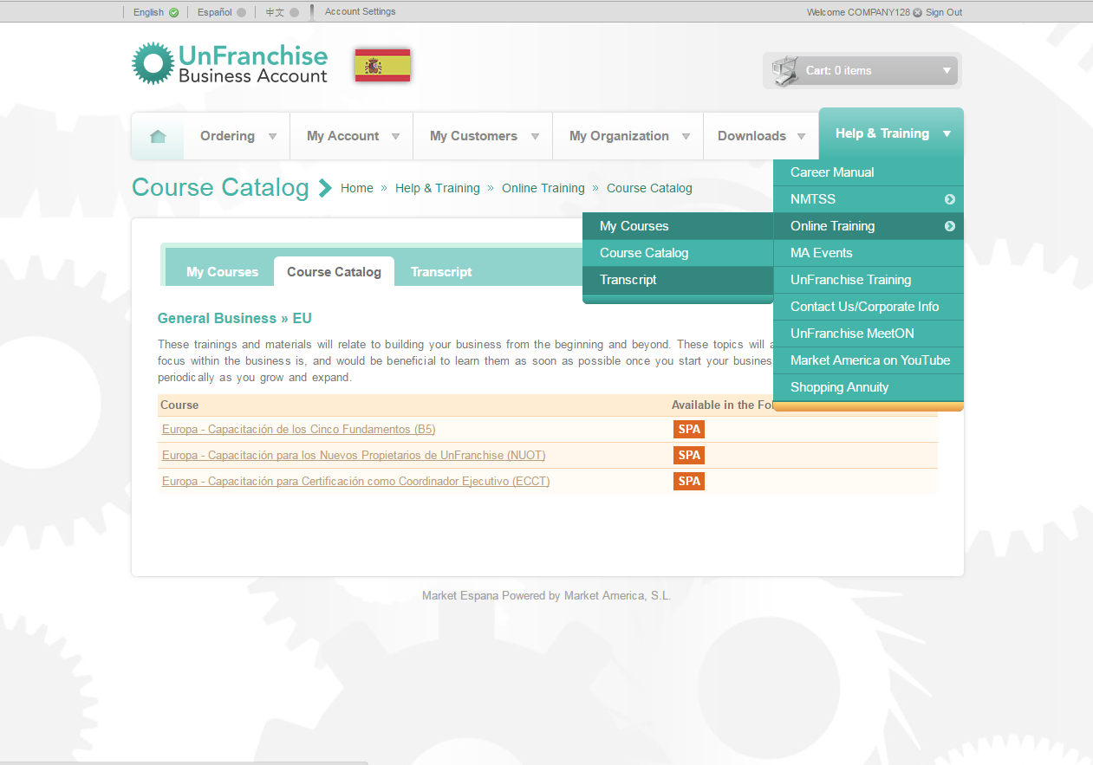
Tutorial videos explaining this process are available in Help & Training > Online Training > Course Catalog

Slide 45
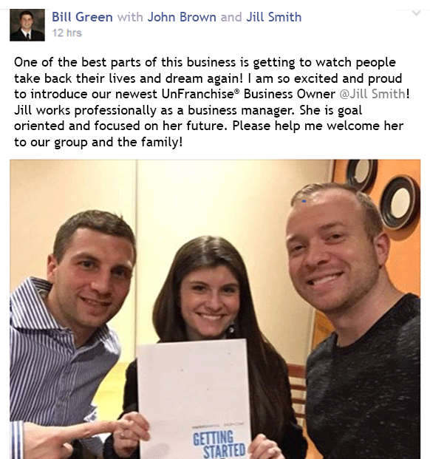
Use social media to welcome new business partners to the team and getting them started on the path to success

Slide 46
Step 2 - Create
BV: BUSINESS VOLUME BV is the point value assigned to exclusive branded products
IBV: INTERNET BUSINESS VOLUME IBV is the point value assigned to any of our Partner Store products

Slide 47
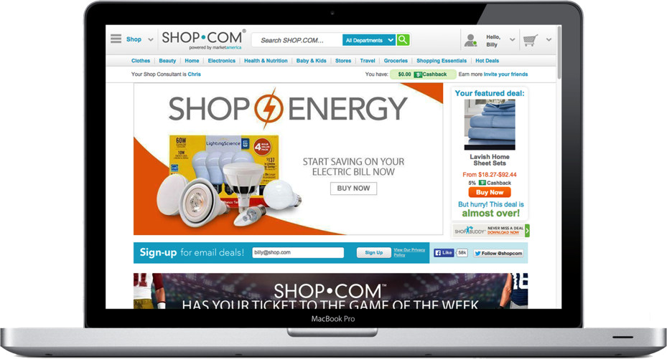
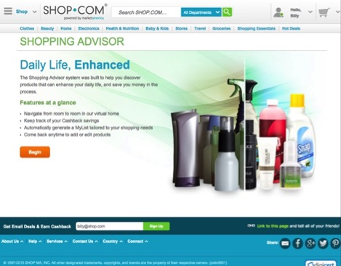
WAYS TO CREATE BV & IBV:
Personal use and shopping
Customer sales and shopping
AutoShip programs
Internet marketing
One-to-One marketing
Social media
Shopping Annuity
Shopping Advisor
ES.SHOP.COM

Slide 48
The Shopping Annuity®
You’re Already Spending It…
Why Not Convert Your Spending Into Earning?

Slide 49
It Begins by Adjusting
Your Shopping Behaviors

Slide 50
The Shopping Annuity begins with each UFO completing the Shopping Annuity assessment (www.shoppingannuity.com)
1
Create BV with our exclusive brands
2
Create IBV with partner stores on ES.SHOP.COM
Four Steps to build a shopping annuity®
3
Create duplication
4
Create BV and IBV with customers
Notes:
TRAINERS NOTES:
Transitional slide.
The big point to make here is that there is proven system and tools to support the actions required to be successful. You don’t have to ambiguously go about funding your shopping annuity. You can make calculated decisions and duplicate that process with your team to create a shopping annuity for yourself.

Slide 51
Exclusive brands
€
Better PRODUCTS
Better Prices
SHOP Tracker for customers
Start identifying which of the company’s exclusive brands you could use instead of other brands to fund your Shopping Annuity®
Notes:
TRAINERS NOTES:
Best of all, we aren’t asking you to sacrifice quality or price. Our exclusive brands are superior products, with better prices than the competition and we pay you Cashback for purchasing them.
Not to mention, by choosing these superior products, you are funding your Shopping Annuity

Slide 52
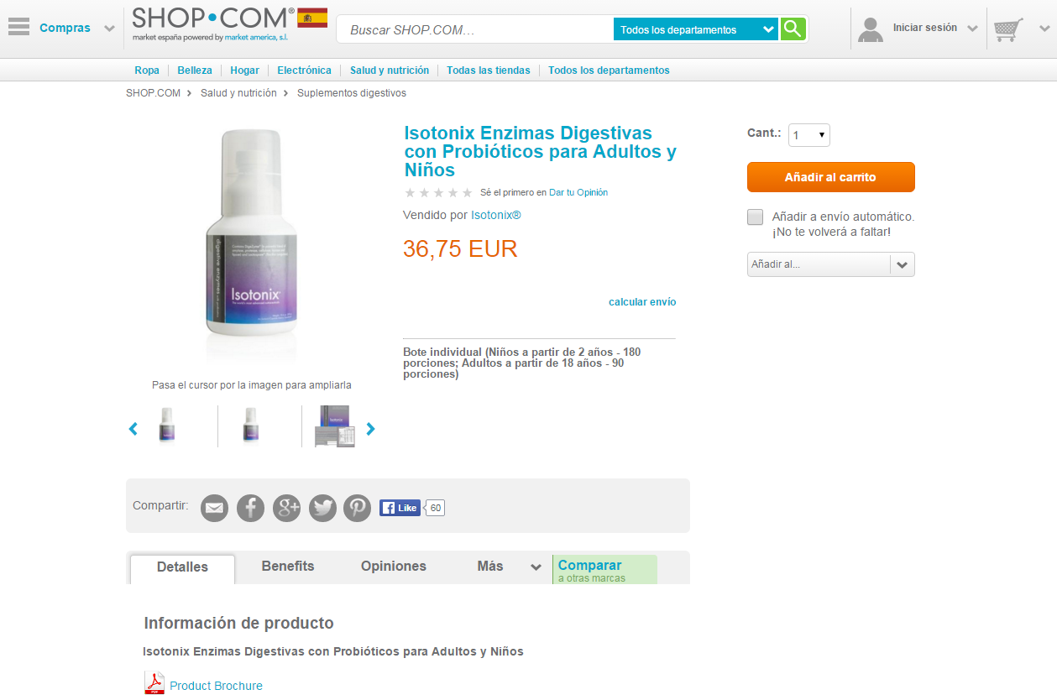
Share pages increase exposure to your favorite exclusive brands
ES.SHOP.COM

Slide 53
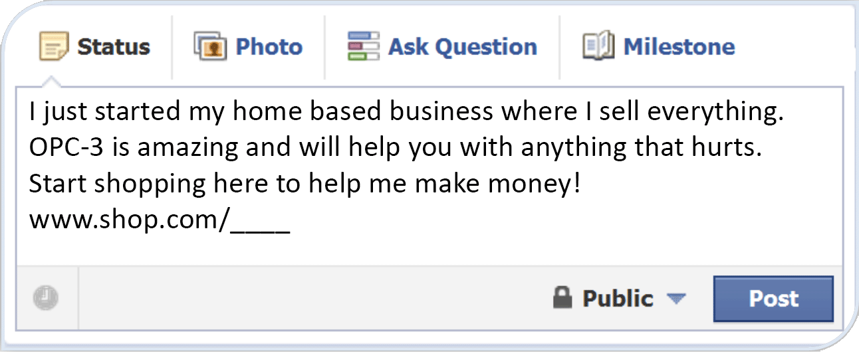
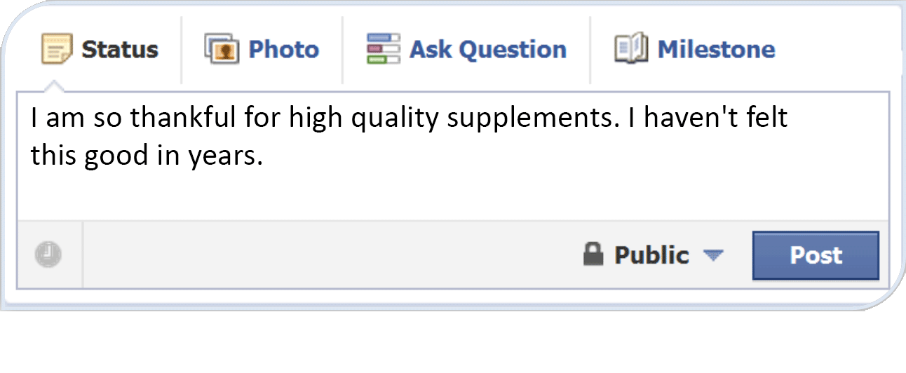
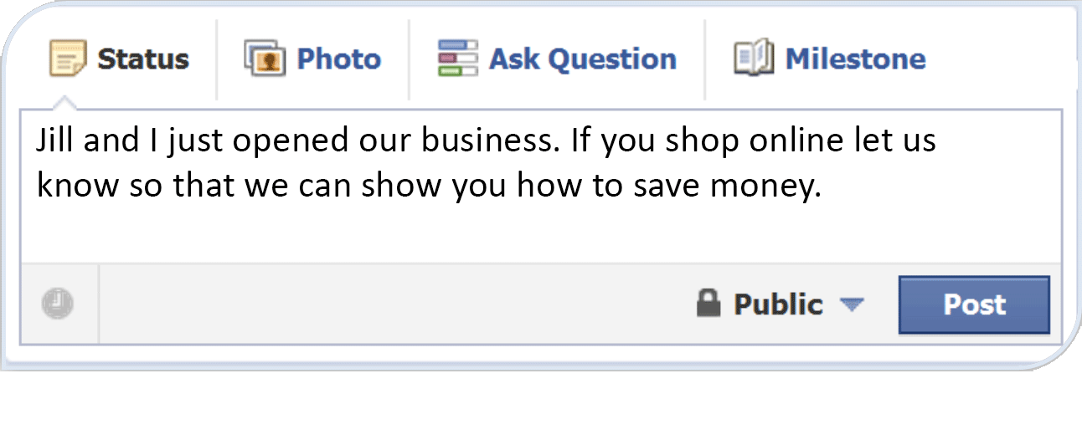
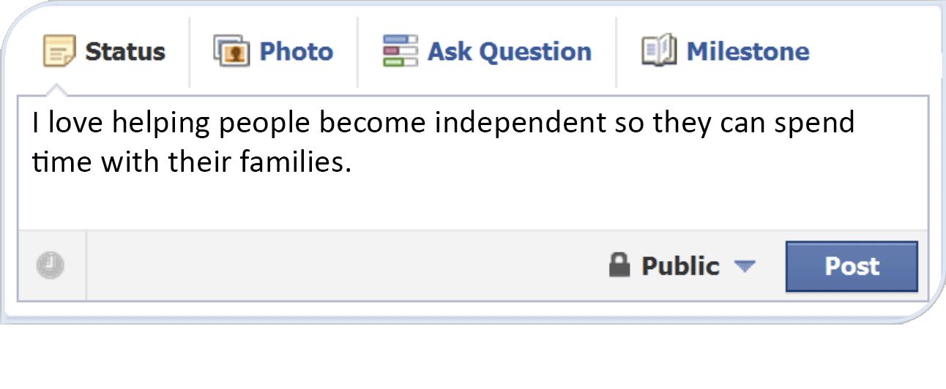
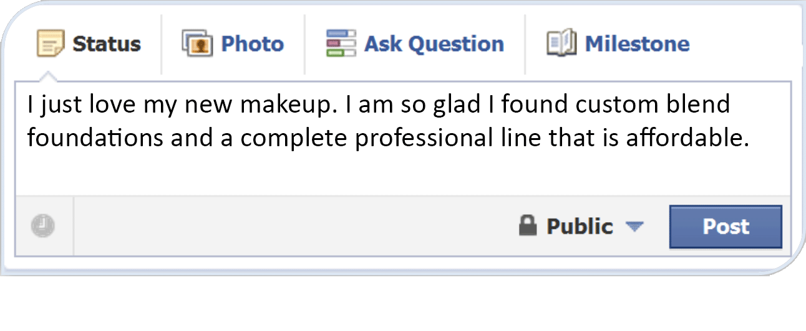
Creating curiosity will lead people to ask questions to find out what you are posting about
Do not make any false or misleading claims
Less can be more, do not post too frequently
Maintain a balance between personal and business posts

Slide 54
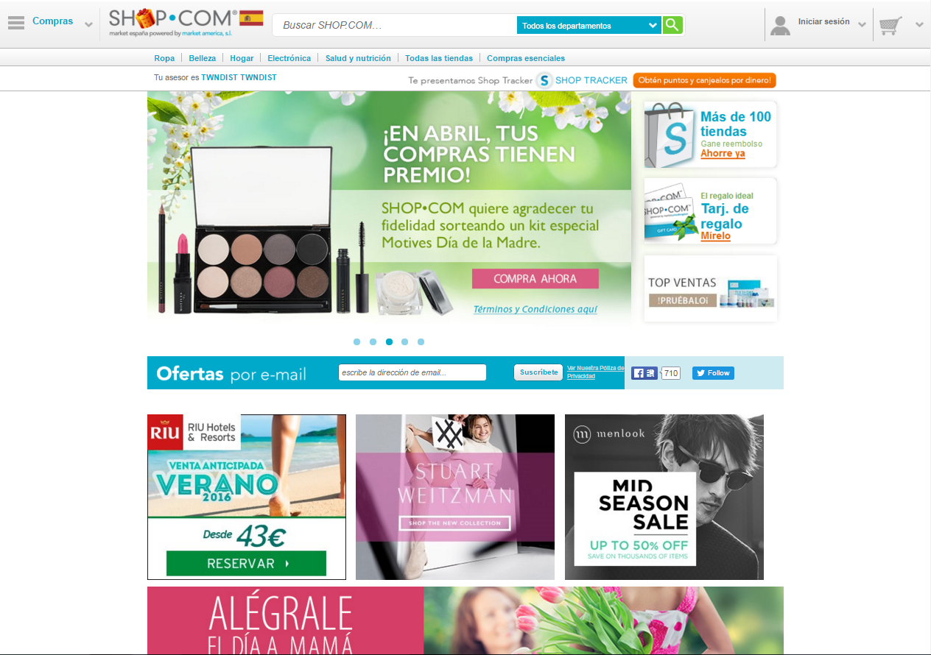
Be sure you are signed in to your ES.SHOP.COM website when shopping; creating IBV

Slide 55
For more information about creating volume:
Basic 5 Training
General Product Training
UnFranchise.MeetOn.com
UnFranchiseTraining.com > Stores and Products
Product Symposium
International Convention and World Conference

Slide 56
PRECIO NUEVO
UnFranchise® Cost
Suggested Retail Price
What UFO’s pay for products
and services
What the company suggests for retailing products, goods and services

Slide 57
UnFranchise Owners are completely responsible for collecting, remitting and reporting their own sales tax
Consult your tax accountant for further details or questions
Sales Tax

Slide 58
Record Keeping
Expenses
Income
Trainings and admission fees (tickets)
Administrative (UFMS) and shipping costs
Advertising and promotional materials
Automobile expenses (mileage)
Travel expenses (airfare)
Lodging and meals
Entertainment of prospects and teammates
Business equipment (computer, etc.)
Office supplies (paper, ink)
Professional fees (tax preparation, etc.)
Profit from retail sales of products
Commissions and bonuses received from the Management Performance Compensation Plan.
* Always consult your tax accountant

Slide 59
Step 3 – QUALIFY
Qualify your Business Development Center (BDC) with 200 BV which opens both your left and right BV and IBV banks
Once your Business Development Center has been qualified (200 BV) it will begin to accumulate BV and IBV
Volume does not accumulate in BDCs that are not qualified
Qualification is only needed one time if requirements are maintained

Slide 60
Personal Volume and Group Volume All volume is personal volume (PBV/PIBV) where it is placed and flows up as group volume (GBV/GIBV) in the banks of qualified BDCs
600 BV
200 BV placed in the 001 is PBV in the 001 and accrues as GBV in the banks it flows up through
PBV is used to qualify a BDC (200 BV) and to exercise the Monthly Accrual Option (typically UnFranchise® AutoShip, placed in 001 BDC)
PBV/PIBV does NOT accrue towards commissions in the banks of the BDC in which it is placed (keeps you active)
GBV is used to calculate commissions and bonuses
200 BV
200 BV
200 BV
200 BV placed in the 002 and 003 is PBV in those BDCs and accrues as GBV in the banks it flows up through

Slide 61
Start Date
Qualification Date
The date when an application is entered at Market America and an Independent UnFranchise Business is created in the database
An UnFranchise Owner’s Q-date is the FRIDAY of the week in which the UnFranchise Owner’s initial BDC became Qualified
Used to determine your Start Month (when you will renew each year)
This is the date for which both monthly and quarterly requirements are based
Is treated the same as a
Q-Date for Sales Representatives
This date will never change as long as an UnFranchise Owner remains Active

Slide 62
Quarter
For Qualified UnFranchise® Owners
For Sales Representatives and
unqualified UnFranchise Owners
Based on the UnFranchise Owner's
Q-date; also called a “three Q-date period”
Based on the Start date; also called a
“three start date period”
Begin on Saturday
End on Friday three months later, the week in which the Q-Date falls
The next quarter begins the following day (Saturday)
Quarters

Slide 63
Jan 10 Start date Jan 13 Q-Date
End of Quarter
End of Quarter
End of Quarter
Start Date Q-Date End of Q-Month

Slide 64
Monthly Accrual Option (Satisfied by UnFranchise® AutoShip)
Gives UnFranchise Owners the ability to continue to accrue GBV month to month (365 days rolling) and GIBV month to month (730 days rolling)
Maintain a subscription to UFMS – 18,25 €/month
UFMS (UnFranchise Management System) is a system of management services, reports and tools designed to help manage your business
2. Assign a minimum amount of PBV to their BDC-001 each month to accrue GBV
UnFranchise Owner – no commission earned – 50 PBV
Coordinator – earned first 210 €commission – 100 PBV
Executive Coordinator and higher – earned the 420 € commission for 5000/5000 BV – 150 PBV
3. Assign a minimum amount of PIBV to their BDC-001 each month to accrue GIBV
UnFranchise Owner – no IBV commission earned – 10 IBV
Earned first 210 €IBV commission – 20 IBV
Earned the 420 € IBV commission for 5000/5000 IBV – 30 IBV
IBV Monthly criteria does not increase with BV commissions

Slide 65
Monthly Accrual Option for all personal BDCs is satisfied when criteria are met in the 001-BDC
Maximum monthly BV criteria is 150
Maximum monthly IBV criteria is 30
One monthly UFMS subscription maintains both BV and IBV accrual
Monthly Accrual Option

Slide 66
UnFranchise® AutoShip (Transfer Buying) defaults to 3rd Q-Month initially
A standing order that is shipped monthly to satisfy the criteria of the Monthly Accrual Option
AutoShip products are pre-selected with Fast Start Kit purchase. Products can be changed if desired
Paid for by bank draft or credit card (recommended two cards on file)
Invoiced on Tuesday, 17 days prior to the end (Friday) of the Monthly Q-Date Period
Designed to satisfy BV/IBV and UFMS criteria
Helps you maintain the Monthly Accrual Option which allows volume to accrue month to month without interruption (prevents Red Flush)
Products can be changed as needed (no later than Friday at noon before the Tuesday that it invoices)

Slide 67
Jan 6 Q-Date End of Quarter
End of Quarter
End of Quarter
End of Quarter
Q-Date End of Q-Month UnFranchise AutoShip Invoices

Slide 68
Jan 13 Q-Date End of Quarter
Note: Two Autoships in May
Note: No Autoship in April
End of Quarter
Note: No Autoship in September
Note: Two Autoships in October
End of Quarter
End of Quarter
Q-Date End of Q-Month UnFranchise AutoShip Invoices

Slide 69
Add everything used monthly to your UnFranchise® AutoShip Order
Any amount over the monthly criteria based on your BV/IBV level will be placed according to the Excess BV/IBV Placement settings
Accrual Protection (Insured Transfer Buy Rider) will, if needed, automatically double or triple the BV or IBV items on the order when the monthly criteria increases after earning commissions
This prevents a red flush

Slide 70
Submit 50 BV and 10 IBV in BDC-001 by the end of first quarter
(assuming no commissions have been earned)
50 BV criterion is for the MPCP
10 IBV criterion is for the IBVCP
Subscribe to one month of UnFranchise Management System (UFMS) in the last month of the first quarter
(assuming no commissions have been earned)
First-Quarter Grace Period
(Qualified UnFranchise® Owners only)
Correct enrollment in UnFranchise AutoShip meets these criteria

Slide 71
If a commission has been earned within the first quarter, the First Quarter Grace Period no longer applies
Monthly Accrual Option criteria may change
Consult with senior partners and the Career Manual
First-Quarter Grace Period
(Qualified UnFranchise® Owners only)
This is a time sensitive issue

Slide 72
Green (Good) Flush
Banks reset to zero (0) because you accumulated 5000 BV or IBV in the left and right banks of that BDC and received the 420 € Commission
420 € (5000/5000)
200 BV
Potential for a weekly green flush
BV and IBV green flush independently of one another
Only affects the BDC green flushing (does not reset other personal BDC banks)
Reflected in reports twelve days following green flush

Slide 73
Red (Bad) Flush
All personal BDC banks reset to zero (0) because you did not exercise the Monthly Accrual Option (BV or IBV)
Correctly enrolling in UnFranchise® AutoShip will prevent red flushes
No commission earned
200 BV
Reasons:
Did not place 50/100/150 BV in your 001 BDC (will affect BV only)
Did not place 10/20/30 IBV in your 001 BDC (will affect IBV only)
Did not purchase your monthly UFMS subscription (will affect both BV and IBV)
Potential red flush monthly
Does not affect qualification (200 BV)
Does not affect senior partner’s BV or IBV
All personal BDC banks red flush
Reflected in reports twelve days following red flush

Slide 74
Qualified/Active Independent UnFranchise® Owner
There are three requirements to remain Qualified/Active:
Current UnFranchise Owner Sales Report (Form 1000) on file
Minimum of two retail receipts totaling 140 € in sales
Submit Form 1000 every quarter by 11:59 pm GMT Friday (the end of their Quarter)
Online sales may only be made at ES.SHOP.COM website or other Market America websites
Once two receipts totaling 140 € are generated (for sales made through Market America websites or entered in Sales Receipt Entry) the quarterly Form 1000 will automatically submit for the 001-BDC
Quarterly
150 quarterly PBV in any personal BDCs (001, 002, 003, etc.)
Does not change with UnFranchise Level
Successful Monthly Accrual Option satisfies this requirement
Current subscription (Annual Renewal)
Renewal of the subscription is required each year by the end of the Start Month (70,00 €)
The month in which the Start Date falls is the Start Month
Auto Renewal is recommended to automatically renew the subscription each year at the beginning of the Start Month
Annually

Slide 75
This can be completed anytime in the quarter, a warning email is sent 30 days before the end of the quarter if requirement not met

Slide 76
If customers purchase via Market America websites or if sales receipts are manually entered online, then an email will be sent confirming automatic Form 1000 completion when sufficient purchases have been made in the quarter

Slide 77
After receiving email confirmation of automatic Form 1000 completion, verify Form 1000 requirement is met

Slide 78
If not opted in, submit paper Annual Renewal form during Start Month

Slide 79
Purge
BV and IBV totals on the left and right reset to zero (0) in all personal BDC’s
/ unqualified
No Commission earned
200 BV
Potential quarterly (Friday, last day of the quarter) and annually (end of Start Month)
Group BV and IBV in all personal BDCs resets to zero (0)
Personal BV and IBV in all personal BDCs resets to zero (0)
All personal volume (BV/IBV placed in personal BDCs) is removed from senior partner banks (where it accumulates as group volume) unless it has flushed
The UnFranchise® Owner becomes unqualified/inactive (may affect sponsor’s activation)
Reflected in reports twelve days following purge

Slide 80
Reasons for Purge
Not having a current UnFranchise® Owner Sales Report (Form 1000) on file
Not placing 150 quarterly BV in any of your personal BDCs (001, 002, 003, etc.)
Not having a current subscription (Annual Renewal)
What to do after a Purge*
Requalify any personal BDC(s) (typically 001 first) with 200 BV to accrue volume and count towards activation
Submit a new Form 1000 for any BDC(s) to be eligible to earn commissions
Submit paper application with Late Renewal checked if purge is due to non-renewal (then requalify and submit a new Form 1000)
* Requalify within 270 days to maintain current BDC genealogy location

Slide 81
Personally sponsor (partner) and place one qualified UnFranchise® Owner in your left and right organizations
All UFOs start with three BDCs (not shown on all diagrams)
Once a BDC is activated, it is eligible to earn commissions

Slide 82
Sponsoring Strategy
First Personally Sponsored UFO Placed on Common Leg
Activate by Sponsoring on Opposite Side
First personally sponsored UFO
Activation with personally sponsored UFO
Recommended that groups (family, co-workers, close friends, etc.) be placed in same leg to foster teamwork and minimize competition
Do not give away personal sponsorship
To count for activation, personally sponsored UFOs must be qualified

Slide 83
Sponsorship vs. Placement
All UFOs start with three BDCs (not shown on all diagrams)
Example: You personally sponsored Mark, Kate and Matt. Although Matt is personally sponsored by you, his placement is on the left side of Dr. Jones’s Business Development Centers (002 left)

Slide 84
Volume Placement Strategy Before Activation
No BV or IBV accrual limit on common leg
≤ 800-1000 BV or IBV until activation
First personally sponsored UFO on common leg
If you reach 1200/1200 BV or IBV before activation, that commission is forfeited
Recommended volume accrual on the side where you have not personally sponsored is no more than 800-1000 BV or IBV

Slide 85
Step 5 – TEACH, MANAGE, AND SUPPORT OTHERS
People Lead To People
1. Apply
2. Create
3. Qualify
4. Activate
*Green indicates personally sponsored UnFranchise® Owner

Slide 86
Objectives For New UnFranchise® Owners
Use and sell the products
Create a customer base and cash flow
Use and promote the Shopping Annuity®
Attend trainings and sell tickets (education)
Share the business
Personally sponsor two and help to activate
Build an organization and volume with a team of other UnFranchise Owners to earn 210 € or more monthly in commissions

Slide 87
Compensation earned for accrued group BV and IBV totals in activated BDCs
An UnFranchise® Owner must be qualified, active, and activated to be eligible to earn any commissions
Commissions are direct deposited two weeks after the Friday when they are earned
UnFranchise Owners are paid commissions as a result of products moving to end consumers. These products are used and retailed by all UFOs within an organization
Commissions

Slide 88
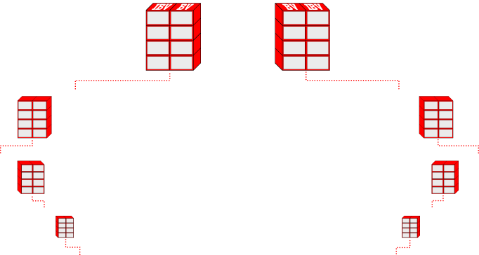
Our Tracking System Searches Daily to Infinity
The system tracks purchases and sales made by you, your customers and your team.
You earn retail profit for your personal sales and 100% credit for all volume generated within your organization.

Slide 89
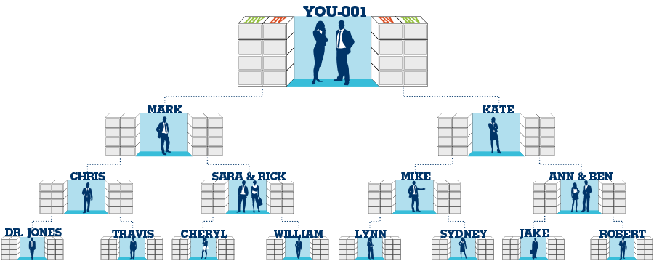
How Commissions are Earned
BV and IBV are tracked daily and commissions are calculated weekly on Friday at 11:59 pm GMT
BV
IBV
= 420 €
5,000
5,000
= 420 €
= 210 €
3,600
3,600
= 210 €
= 210 €
2,400
2,400
= 210 €
= 210 €
1,200
1,200
= 210 €
Total 1,050 €
1,050 €
When exercising the Monthly Accrual Option, BV can accrue up to 365 days and IBV can accrue up to 730 days
Total weekly potential 2,100 € per BDC

Slide 90
Commission Forfeit Accruing enough volume on the left and right of a BDC to meet a given payout increment (GBV or GIBV amounts) and not receiving the commission
1200 BV or IBV
1200 BV or IBV
First personally sponsored UFO in common leg
Reasons for Commission Forfeit
Not having two personally sponsored, qualified UnFranchise® Owners (one on the left and one on the right) when reaching a payout increment
Example: Reaching 1200 BV on the left and 1200 BV on the right before becoming activated

Slide 91
Reasons for Commission Forfeit (cont.)
Not completing the required Forms, 925 and 1001 (Executive Coordinator Agreements). Both must be completed after earning the first 210 € commission. Normally completed during UnFranchise® Registration. (28 day commission hold allows for completion)
Not completing the three required trainings NUOT, Basic 5, and ECCT. All three must be taken within 28 days of completing the BV pay cycle the first time (5000/5000 BV). (28 day commission hold allows for completion)
Recommend completing all three trainings as soon as possible
Notes:
TRAINER’S NOTES:
To Avoid Forfeit….
Get forms in early. Form 925 one time only (should be during sign-in), Form1001 one time only (should be during sign-in), Form 1000 quarterly Form Annual Renewal
Attend all three required trainings. Basic Five (B5) New UnFranchise Owner Training (NUOT) Executive Coordinator Certification Training (ECCT)

Slide 92
How Management Bonuses are Earned
420 € bonus paid for teaching and helping others to achieve financial success
5000 BV
5000 BV
Potential 2520 € per week, per BDC
5000 BV
5000 BV
5000 BV
5000 BV
Every time you and any BDC in your left sales organization plus any BDC in your right sales organization completes the BV commission cycle in the same week, you earn a management bonus of 420 € .

Slide 93
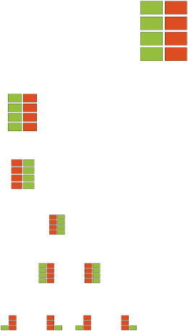
Re-Entry – Earn More Income
Open additional Business Development Centers to increase your commissions
Earned when the commission is paid the first time for reaching the 5000/5000 BV pay level
Only awarded once per BDC and does not expire
Must be placed according to policy and qualified with 200 BV
No additional Monthly Accrual Option criteria and no additional Quarterly Form 1000 requirements
Consult with senior partner before placing a Re-Entry
200 BV

Slide 94
Recommended Strategies
Do not develop more than two organizations at the same time
Build only two organizations in depth at one time
Do not give away personal sponsorship
Continue to sponsor and place people below your current team
Do not place personally sponsored business partners on both sides of a UFO in your organization
Support the leaders in your organization with coaching and mentoring
Do not initially qualify a BDC for anyone (pay for the registration)
Conduct Wellness 101, etc. to help prospects create customers and retail profit to qualify their business
Do not expect BV and/or UFO placement from business partners
Retail, recruit and place new UFOs and volume at the bottom of your organization

Slide 95
UnFranchise® Levels and Requirements
Coordinator
An UnFranchise Owner who is qualified, activated, and has earned at least the first commission (210€)
Submit Form 925 - Executive Coordinator Acknowledgement & Agreement
Agreement to attend all three required trainings and complied with the 70% rule
Submit Form 1001 - Executive Coordinator Qualification and Application Form
Agreement to accept responsibility of Executive Coordinator
Both of these forms are part of the online UnFranchise Registration and have typically already been completed. Confirm on the UnFranchise Owner Qualification Report.
Monthly Accrual Option criteria increases (100 BV)

Slide 96
UnFranchise® Levels and Requirements
Executive Coordinator
An UnFranchise Owner who has accrued a minimum of 5000 GBV on both the left and right sides of a BDC and has earned the final 420 € commission
Attend an Executive Coordinator Certification Training (ECCT) within 28 days of earning the 420 € commission
Prerequisites for the ECCT are attendance/completion of a New UnFranchise Owner Training (NUOT) and a Basic Five
Monthly Accrual Option criteria increases (150 BV)

Slide 97
UnFranchise® Levels
Master Coordinator
An UnFranchise Owner who has earned a 420 € Management Bonus
5000 BV
5000 BV
Potential 2,520 € per week, per BDC
Prerequisites for the ECCT are attendance/completion of a New UnFranchise Owner Training (NUOT) and a Basic Five
5000 BV
5000 BV
5000 BV
5000 BV
Monthly Accrual Option criteria increases (150 BV)

Slide 98
UnFranchise® Levels
All UnFranchise Levels higher than Master Coordinator are based on commissions and bonuses earned from the MPCP in four consecutive weeks
Recognition statement of income earned:
“has earned a minimum of ________ in four consecutive weeks”
Income should not be stated except as published by Market America

Slide 99
UnFranchise® Levels
Senior Master Coordinator
Field Vice-President
earned ≥ 2100 € in four consecutive weeks
earned ≥ 25200 € in four consecutive weeks
Professional Coordinator
Executive Field Vice-President
earned ≥ 3150 € in four consecutive weeks
earned ≥ 31500 € in four consecutive weeks
Supervising Coordinator
Senior Executive Field Vice-President
earned ≥ 5250 € in four consecutive weeks
earned ≥ 44100 € in four consecutive weeks
National Supervising Coordinator
Field President
earned ≥ 7000 € in four consecutive weeks
earned ≥ 56000 € in four consecutive weeks
Executive Supervising Coordinator
International Field President
earned ≥ 10500 € in four consecutive weeks
earned ≥ 70000 € in four consecutive weeks
Director
International Field Chairman
earned ≥ 12600 € in four consecutive weeks
earned ≥ 87500 € in four consecutive weeks
Executive Director
earned ≥ 17500 € in four consecutive weeks

Slide 100
1
Fast Start Program 250 € (plus tax)
2
Ability to earn immediate retail profits and Cashback
3
Volume Accrual – 365 Days
4
100% credit for all volume
5
Volume and People Placement
Strengths of THE Management Performance Compensation Plan (MPCP)
6
Unlimited Income Potential through additional BDCs

Slide 101
NUOT Review Questions:
What is needed in order to login to the UnFranchise® Business Account?
Q
Rep ID or email and password
A
What are the three required trainings?
Q
NUOT, Basic 5, ECCT
A
What is the difference between a Sales Representative and an UnFranchise Owner?
Q
UFOs pay the subscription fee and can participate in the MPCP and earn commissions and bonuses
A

Slide 102
NUOT Review Questions:
How do you qualify a BDC?
Q
Place 200 BV in that BDC (typically the 001 is qualified first)
A
What occurs on the Friday following the Q-Date each month?
Q
Monthly Accrual Option criteria are due
A
What occurs on the Friday at the end of each UFO quarter?
Q
Form 1000 (140 € in retail sales) and 150 PBV are due
A
What occurs in the Start Month each year?
Q
Annual Renewal, UFO 70,00 € (enroll in Auto Renewal)
A

Slide 103
NUOT Review Questions:
What does it mean to be activated?
Q
Personally sponsor (partner) and maintain one qualified UnFranchise® Owner in your left and right organizations
A
What are the requirements to earn commissions?
Q
Be activated and then reach accumulated pay levels (1200/1200, etc.)
A
Where do you find the training modules?
Q
Online training can be found in the UnFranchise Business Account under Help & Training
PowerPoints and other files can be found at www.UnFranchiseTraining.com
A

Slide 105
New UnFranchise® Owner Training

